Slide 1


Slide 2
NAME OF THE PROJECT Project Report on Data Analysis of Customer Retention in Ecommerce Sector
Submitted To:
Flip Robo Technologies
FLIPROBO SME:
Gulshana Chaudhari
Submitted by:
Mrs. Swati Amit Motugade

Slide 3
ACKNOWLEDGMENT
I would like to express my special gratitude to “Flip Robo” team, who has given me this opportunity to deal with a beautiful dataset and it has helped me to improve my analyzation skills. And I want to express my huge gratitude to Ms. Khushboo Garg (SME Flip Robo), she is the person who has helped me to get out of all the difficulties I faced while doing the project.
A huge thanks to “Data trained” who are the reason behind my Internship at Fliprobo. Last but not least my parents who have been my backbone in every step of my life.
References use in this project:
1. SCIKIT Learn Library Documentation
2. Blogs from towardsdatascience, Analytics Vidya, Medium
3. Andrew Ng Notes on Machine Learning (GitHub)
4. Data Science Projects with Python Second Edition by Packt
5. Hands on Machine learning with scikit learn and tensor flow by Aurelien Geron

Slide 4
Chap 1. Introduction to E-commerce
E-commerce (electronic commerce) is the buying and selling of goods and services, or the transmitting of funds or data, over an electronic network, primarily the internet. These business transactions occur either as business-to-business (B2B), business-to-consumer (B2C), consumer-to-consumer or consumer-to-business.
Top 15 e-commerce Companies in India [2022 Updated List]
1. Amazon | 6. Snapdeal | 11. Rediff
2. Flipkart | 7. FirstCry | 12. MakeMyTrip
3. Myntra | 8.Nykaa | 13. LimeRoad
4. IndiaMART | 9. BookMyShow | 14. Paytm Mall
5. Shopclues | 10. EBay | 15. Ajio

Slide 5
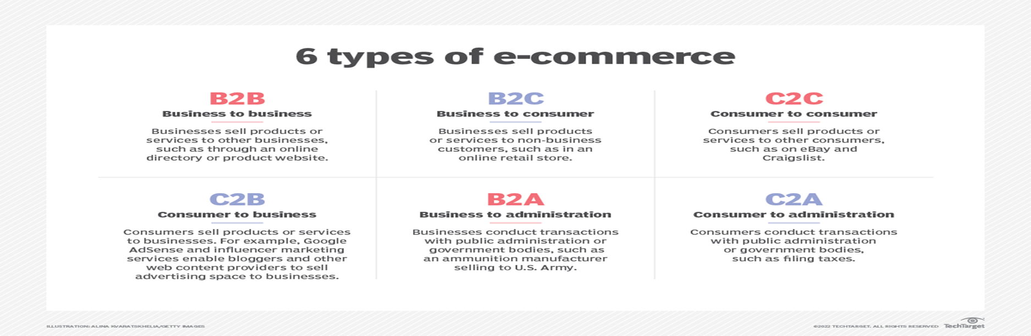

Slide 6
Essential Criteria to Choose the Best eCommerce Company
Serviceability/Pin Code Reach of the E-commerce Websites
Products, Services, And Benefits
Delivery Mechanisms
Delivery Speed
Tracking Visibility
Proof Of Delivery
Returns Management
Track Record And Reviews Of eCommerce Platform

Slide 7
What is Customer Retention?
The customer retention definition in marketing is the process of engaging existing customers to continue buying products or services from your business. It’s different from customer acquisition or lead generation because you’ve already converted the customer at least once.
The best customer retention tactics enable you to form lasting relationships with consumers who will become loyal to your brand. They might even spread the word within their own circles of influence, which can turn them into brand ambassadors.

Slide 8
The Importance of Customer Retention for an Online Business
You might have heard that it’s easier and less expensive to retain customers than to acquire them. The most recent statistics indicate that it’s true.
For one thing, you’ll spend five times less money on customer retention.
Additionally, at best, your probability of selling to an existing customer is at least 40% more likely than converting someone who has never bought from you before.
The probability of selling to an existing customer is 60-70% while the probability of selling to a new prospect is 5-20%.
Existing customers also spend 31 percent more than new leads, and when you release a new product, your loyal customers are 50 percent more likely to give it a shot.

Slide 9
How do you measure customer retention?
To calculate your customer retention rate (CRR) you can use the following simple formula involving the customers you have at the start (S), at the end (E) and customer acquired during the period you're measuring (N).
It looks like this: CRR = ((E-N)/S) x 100.
Astro's example of calculating your CRR:
You have 130 customers at the start of a month. In that month you lose 9 and gain 23 new customers.
Number of customers at end of period = 144
Number of customers at start of period = 130

Slide 10
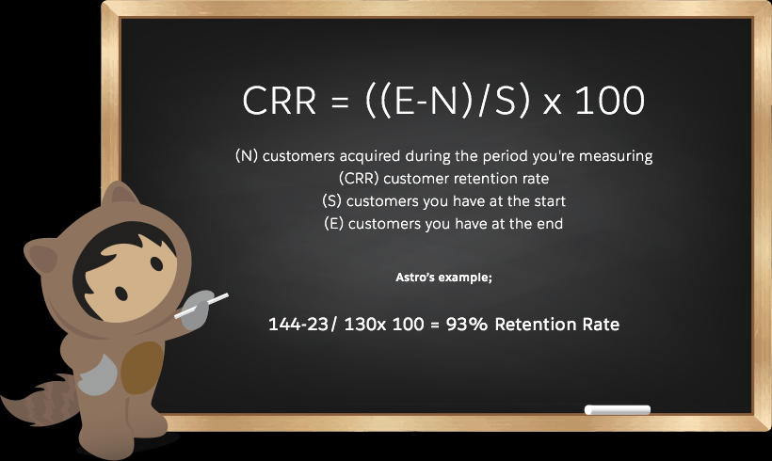

Slide 11
Great Ways To Increase Customer Retention Rates
Improve user onboarding
Create an achievable roadmap with your customers
Use client feedback to find weaknesses and constantly improve
Understand your clients with customer experience and journey mapping
Get personal with social media support
Segment customers to deliver the right content at the right time
Use automated emails to encourage inactive users to take action
Upsell to existing customers
Identify customers that are likely to churn
Create a personalised customer loyalty programme
Create a referral programme

Slide 12
Business Problem Framing
Customer retention strategies enable you to both provide and extract more value from your existing customer base. You want to ensure the customers you worked so hard to acquire stay with you, have a great customer experience, and continue to get value from your products. Therefore, knowing how to maximize the repurchase intention of Indians Therefore, knowing how to maximize the repurchase intention of Indians Therefore, knowing how to maximize the repurchase intention of Indians model for successful online retail business. Success of an online retail website depends on its system quality and how much consumer motivator values are derived through shopping from it.
The research furthermore investigated the factors that influence the online customers repeat purchase intention. The combination of both utilitarian value and hedonistic values are needed to affect the repeat purchase intention (loyalty) positively. The data is collected from the Indian online shoppers. Results indicate the e-retail success factors, which are very much critical for customer satisfaction.

Slide 13
Conceptual Background of the Domain Problem
A successful business strategy today is not only developing costeffective and highly targeted ways to reach out the new customers, it is more about keeping the existing customers engaged in the company. It has been acknowledged that bringing in new customers is expensive. Investment in the acquisition of new customers is six times higher than investing in existing customers. Increased performance in customer retention practices, on the other hand, has been found to create five times more impact than a similar amount of discount or cost of the capital, leading into the more profitable customer relationship.
➢ Studies have suggested that past online shopping experience, perceived usefulness, and customer satisfaction are factors capable of influencing a customer’s repurchase intention.
➢ Website quality (e-store) and the usability of the e-store have also been proposed as being very
vital for e-retail success by studies.
➢ The customer retention model illustrates that for a customer to become loyal to an online retail brand, there must be satisfaction, which arises when the e-tailer possesses a quality system backedup by the proper mix of values.

Slide 14
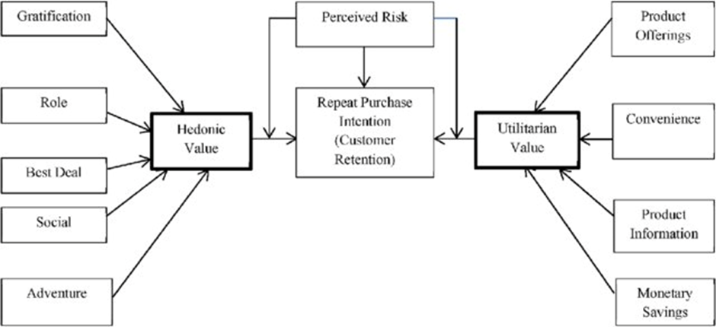
The situation in the market has changed, and the competition has become tougher. Customers have the luxury to choose between many providers. The increasing number of actors in the market has caused a rise in the significance and relevance of customer retention and the planning of a customer retention process is essential in order to achieve the desired level of outcome which is determined in the modern management literature. It focuses on the experience of purchasing the preferred product, instead of the product itself.

Slide 15
Motivation for the Problem Undertaken
The project was the first provided to me by Flip Robo Technologies as a part of the internship programme. The exposure to reathe opportunity to deploy my skillset in solving a real time problem has been the primary motivation.
Our main objective of doing this project is to analyze whether the users are shopping products from e-commerce websites. How did they give feedbacks to these websites on the basis of several positive and negative factors and also the details of the users on basis of factors like age, gender, city etc.

Slide 16
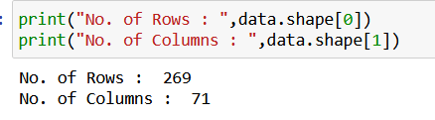
Chap 2 Analytical Problem Framing 1. Data Sources and their formats
The data is collected from the Indian online shoppers. Results indicate the e-retail success factors, which are very much critical for customer satisfaction. There are two sheets (one is detailed) and second is encoded in the excel file.
Here I am using the detailed data sheet.
Our dataset contains 269 rows and 71 columns out of which 1 is Target and remaining 70 are features.

Slide 17
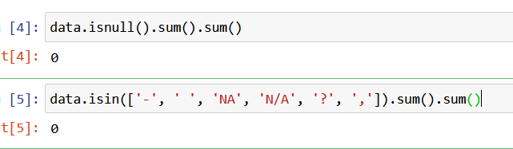
2. Data Pre-processing
Before preprocessing the data, just checked for null values, possible duplicates or any whitespaces ‘ ‘.
There are no null values are present also no whitespaces are present in dataset.
Some duplicates are present in customer review for example Dis-agree and Disagree,Mobile internet and Mobile Internet which are replaced by one of them to made analysis easy since both are same.
Unnecessary spacing in columns name is removed.

Slide 18
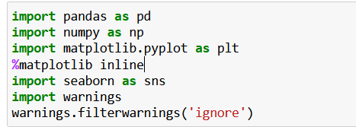
3. Hardware & Software Requirements with Tool Used
Hardware Used –
1. Processor — Intel i5 processor with 2.50GHZ
2. RAM — 8 GB
3. System Type — 64bit OS,x64-based processor
Software utilised –
1.Anaconda – Jupyter Notebook
Libraries Used –

Slide 19
Chap. 3 Models Development & Evaluation
1. Categorization of Features
There are lot of features in dataset. Our objective is to find key conclusions & finding related to data using analysis. The features are categorised into few sections so we can perform analysis data section wise focus on particular area. They are enlisted as below:
➢ General feature describing Population and online shopping feature
➢ Feature describing technological aspects related to internet services & device
➢ Purchase Decision & Payment related features
➢ Website Usability & performance related feature
➢ Online shopping store customer service requirement related features
➢ Feature related to Customer online shopping experiences
➢ Online Shopping Platform related question response by Customer

Slide 20
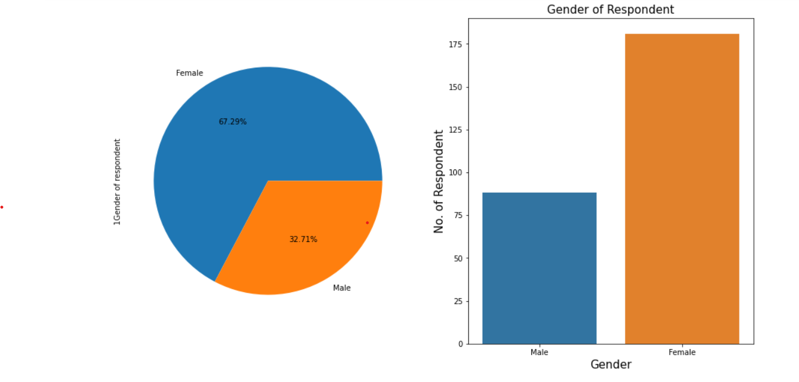
2. VISUALIZATIONS
General feature describing Population and online shopping
Visualization of Gender Distribution of Respondents

Slide 21
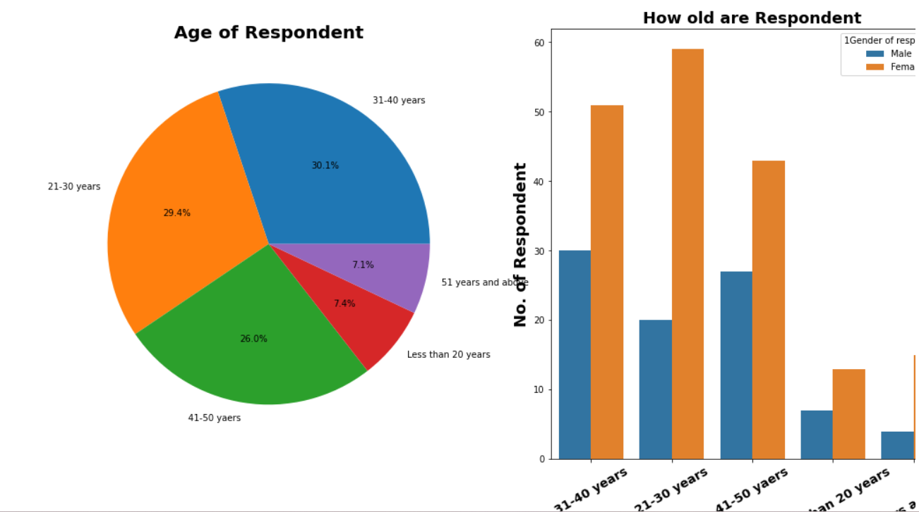
The Majority of Respondent are Female (67.3%) & rest are Male.
This shows that Women are more shopping oriented than Men.
Visualization of Age

Slide 22
Observations
1. 7.4% i.e. 20 respondents are form age group 'less than 20 years'.
2. 29.4% i.e 79 respondents are from age group '21-30 years'.
3. 30.1% i.e. 81 respondents are from age group '31-40 years'.
4. 26.0% i.e. 70 respondents are from age group '41-50 years'.
5. 7.1% i.e. 19 respondents are from age group '51 years and above'.

Slide 23
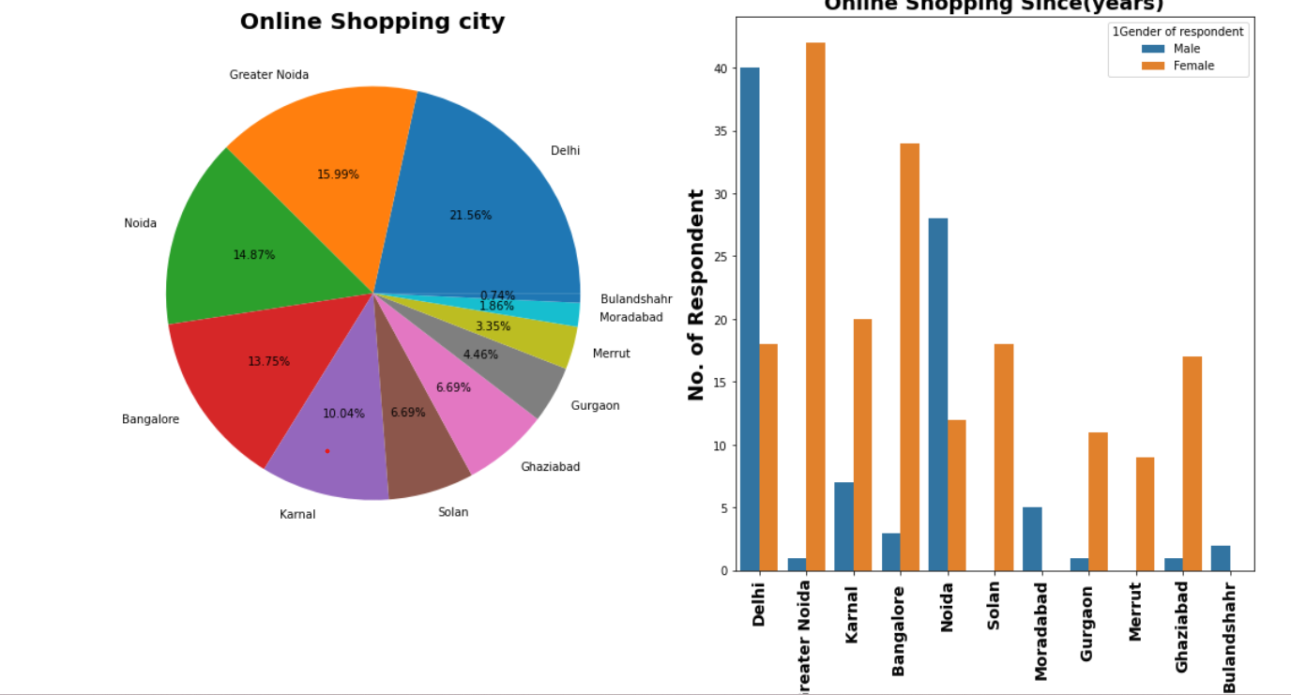
Visualization of City 1. The highest percentage of Online shopping is from city "Delhi". 2. The lowest percentage of Online shopping are from cities "Bulandshahr" and "Moradabad".

Slide 24
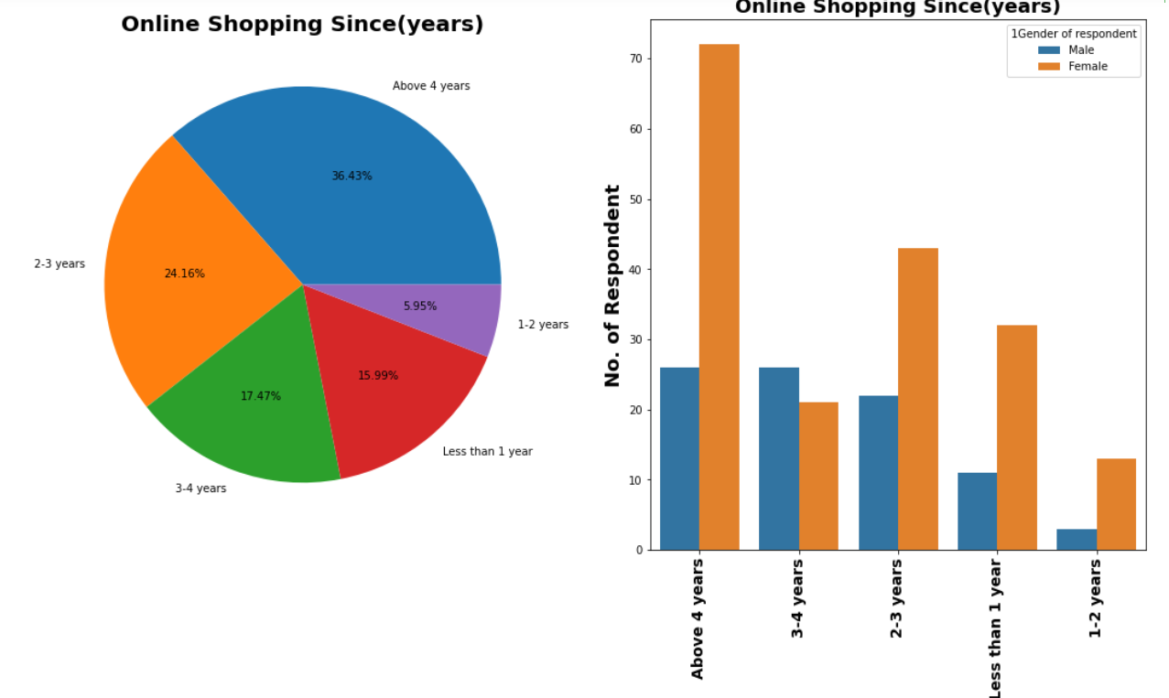
Visualization of Online Shopping Since(years)
Observations:
1. 15.99% i.e. 43 respondents are doing online shopping since less than 1 years.
2. 5.95% i.e. 16 respondents are doing online shopping since last 1-2 years.
3. 24.16% i.e. 65 respondents are doing online shopping since last 2-3 years.'.
4. 17.47% i.e. 47 respondents are doing online shopping since last 3-4 years..
5. 36.43% i.e. 98 respondents are doing online shopping since above last 4 years.

Slide 25
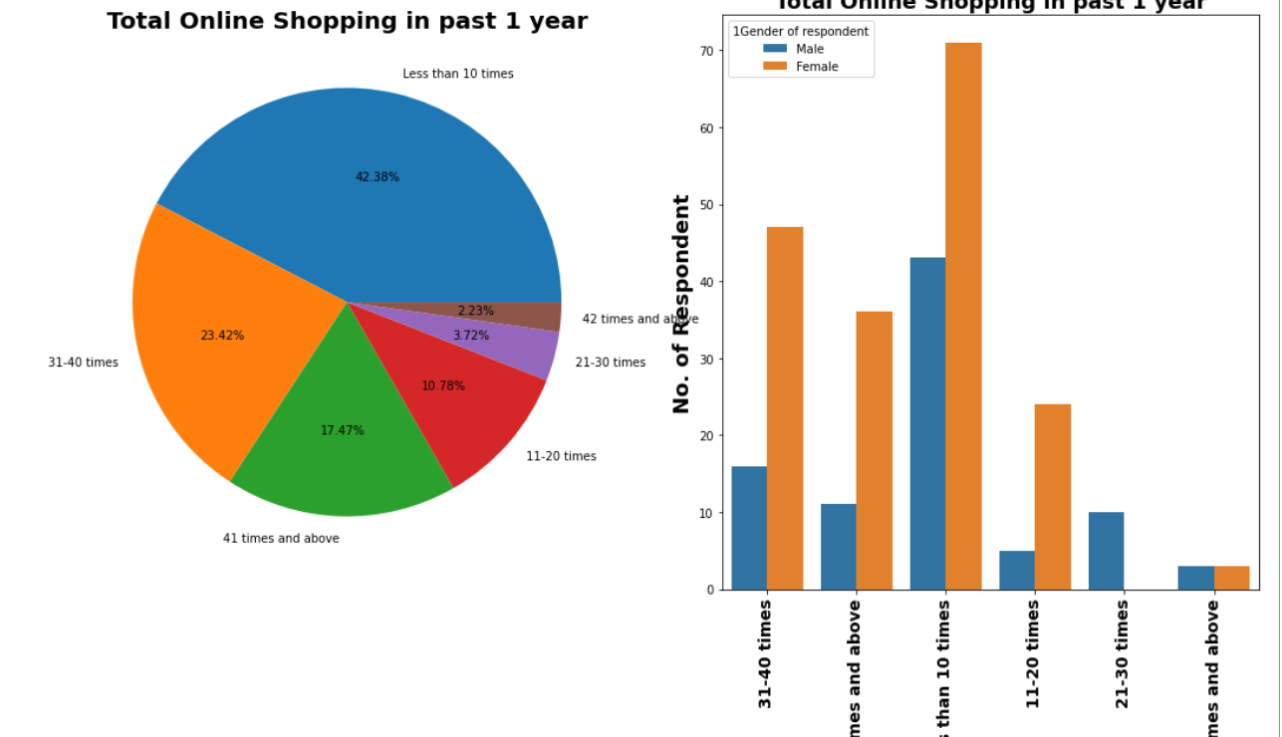
Visualization of Total Online Shopping in past 1 year
Observations:
1. 42.38% respondents made online shopping less than 10 times in past 1 year.
2. 23.42% respondents made online shopping 31-40 times in past 1 year.
3. 19.70% respondents made online shopping 41 times and above in past 1 year.
4. 10.78% respondents made online shopping 11-20 times in a past 1 year.
5. 3.72 respondents made online shopping 21-30 times in the past 1 year.

Slide 26
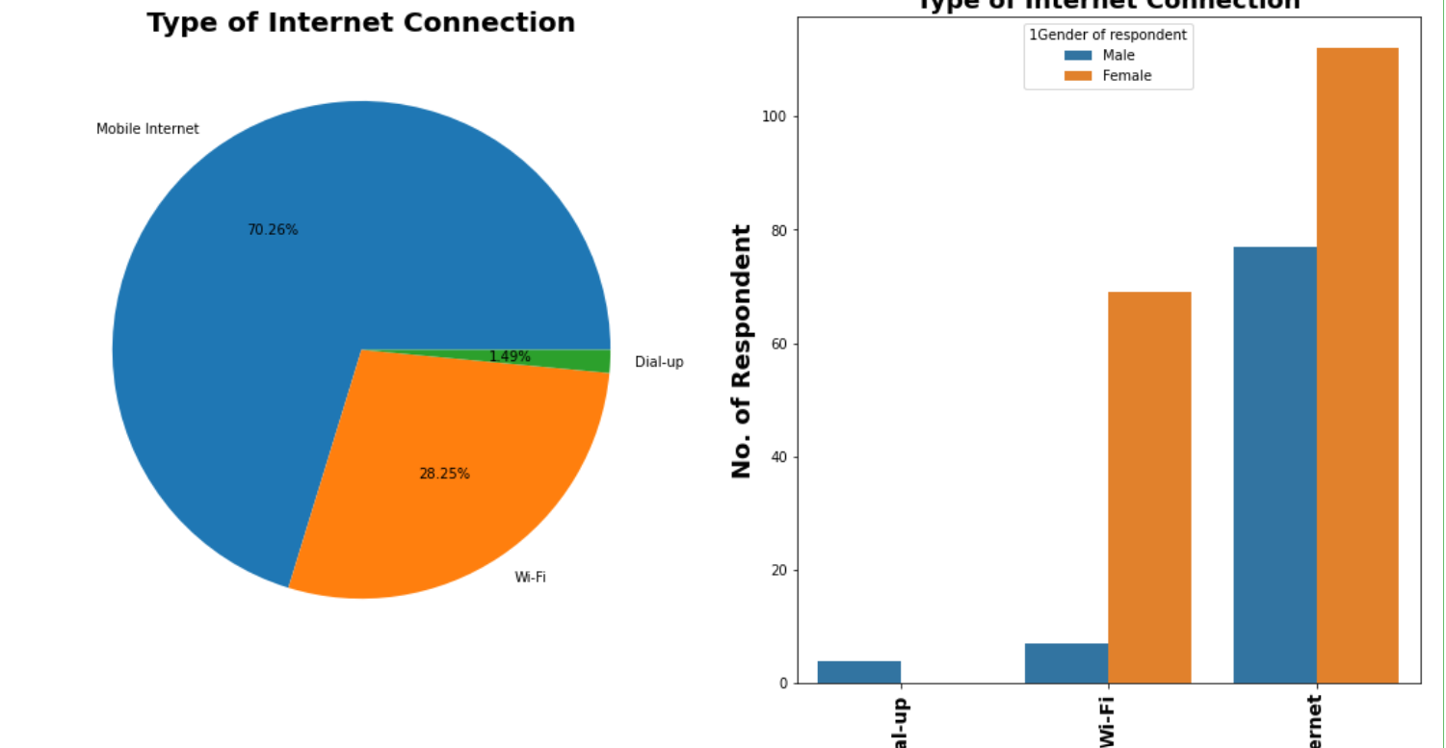
Visualization of Type of Internet Connection
Observations:
1. 70.26% respondents made use of Mobile Internet for online shopping.
2. 28.25% respondents made use of Wi-Fi for online shopping.
3. 1.49% respondents made use of Dial-up for online shopping.

Slide 27
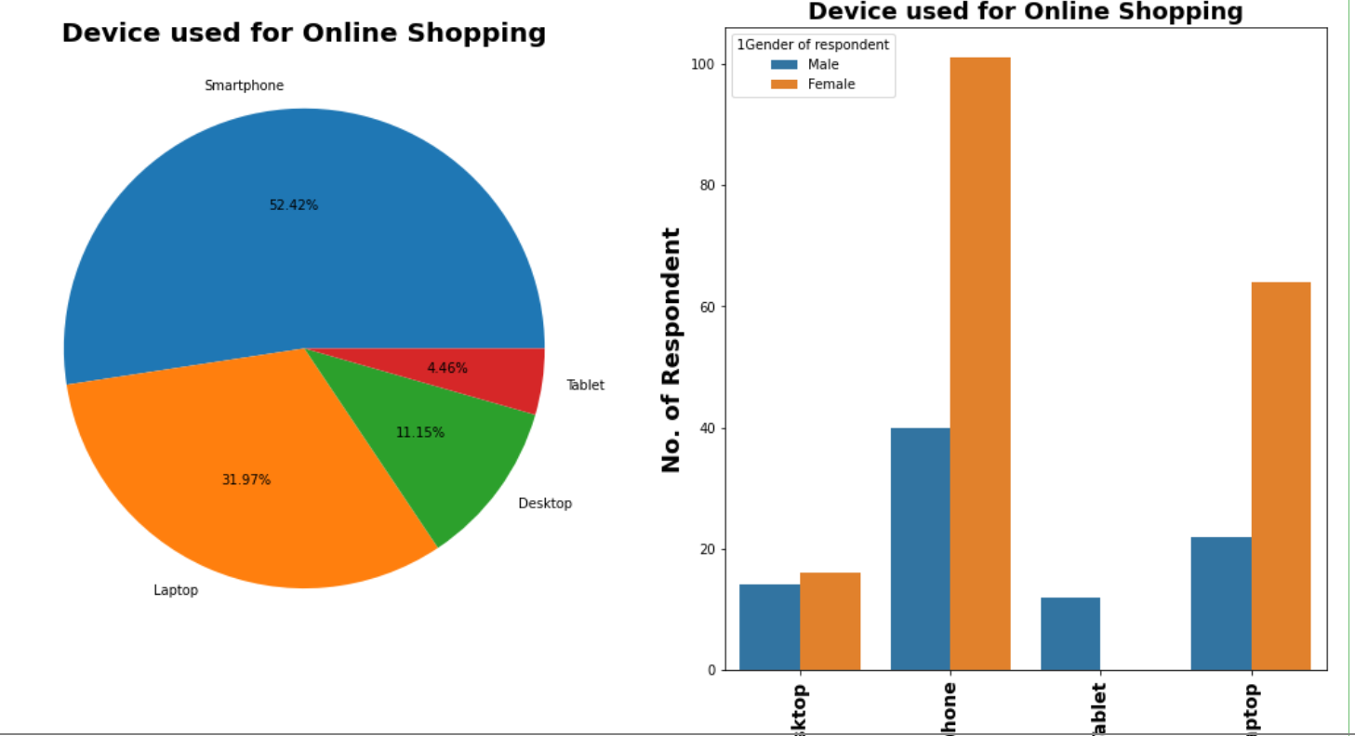
2. Features Describing Technical Aspects Visualization of Device used for Online Shopping
Observations:
1. 52.42% respondents use Smartphones for online shopping.
2. 31.97% respondents use Laptop for online shopping.
3. 11.15% respondents use Desktop for online shopping.
4. 4.46% respondents use Tablet for online shopping.

Slide 28
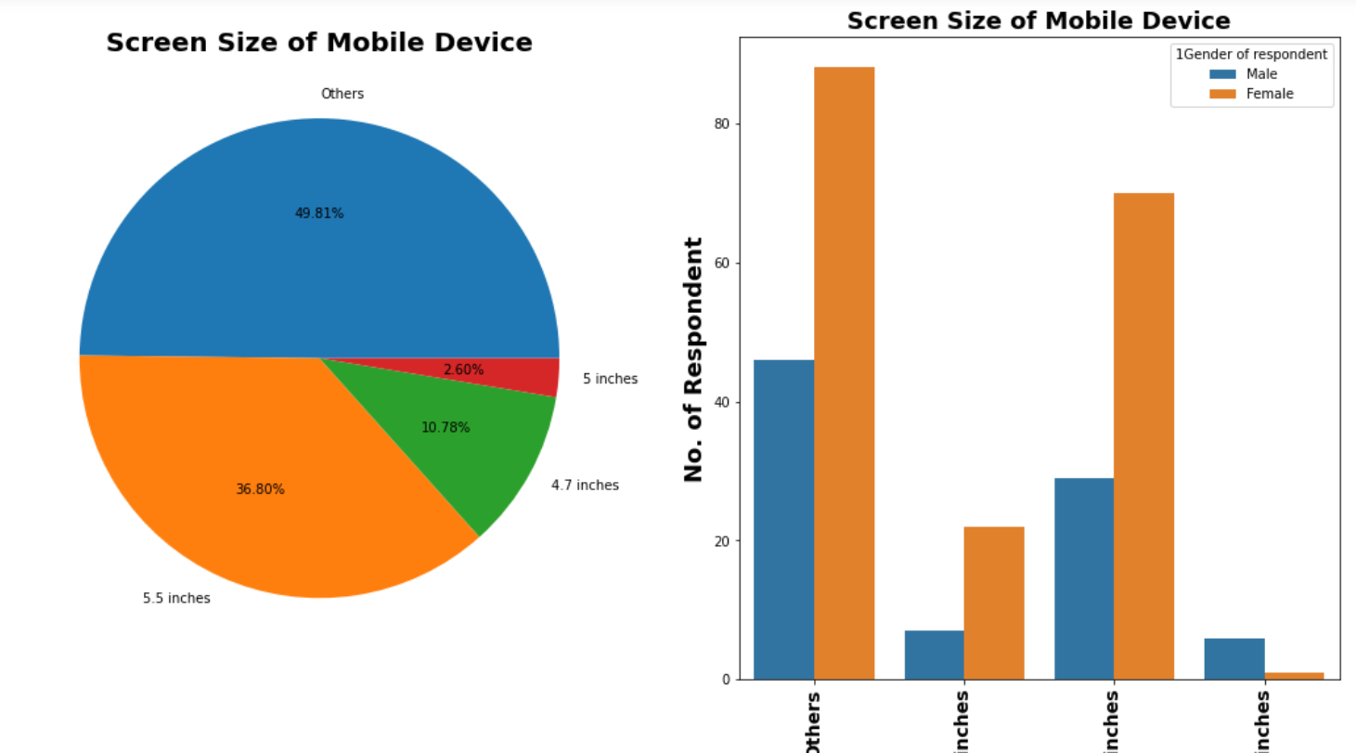
Visualization of Screen Size of Mobile Device
Observations:
1. 49.81% respondents have 'others' screen size of mobile device
2. 36.80% respondents have 5.5 inches screen size of mobile device.
3. 10.78% respondents have 4.7 inches screen size of mobile device.
4. 2.60% respondents have 5 inches screen size of mobile device.

Slide 29
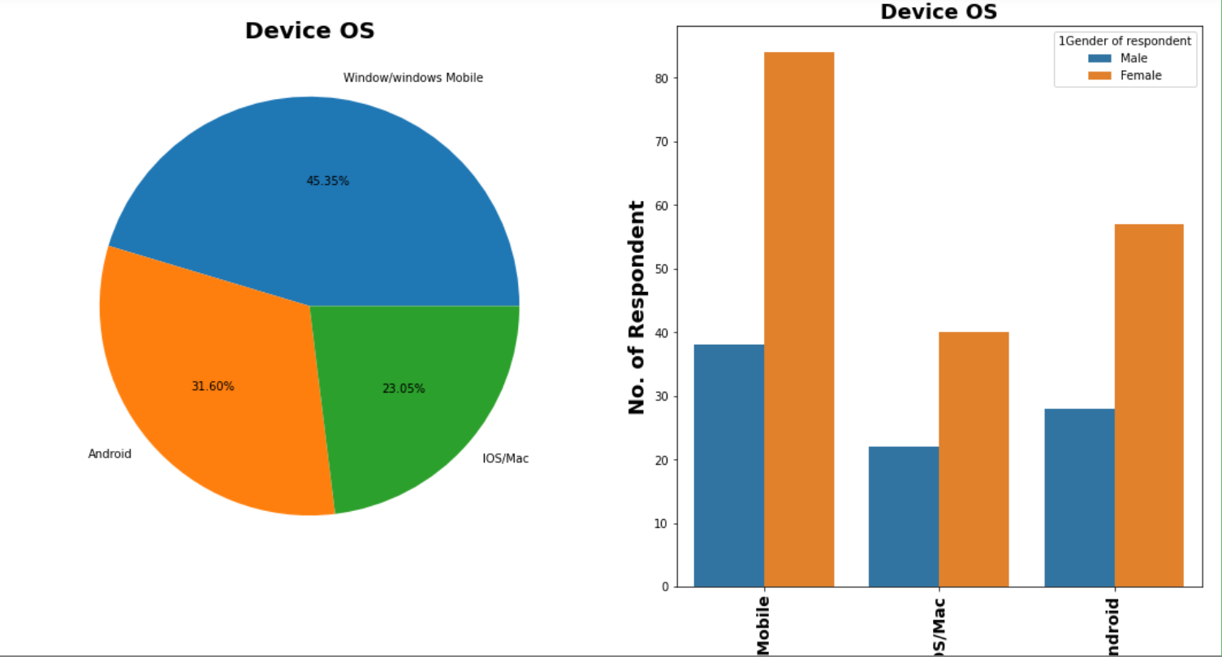
Visualization of Device OS
Observations:
1. 45.35% respondents have Window/windows Mobile OS for device.
2. 31.60% respondents have Android OS for device.
3. 23.05% respondents have IOS/Mac OS for device.

Slide 30
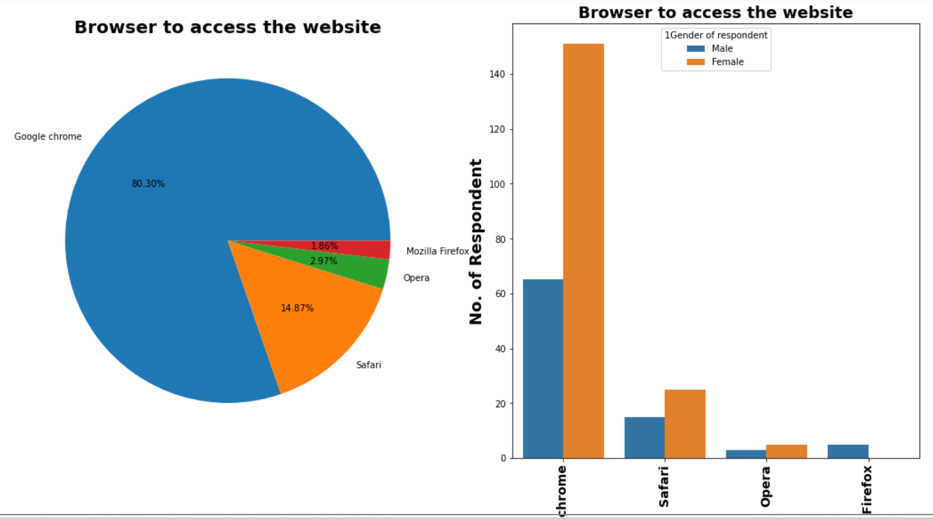
Visualization of Browser to access the website
Observations:
1. 80.30% respondents use Google chrome browser for online shopping.
2. 14.87% respondents use Safari browser for online shopping.
3. 2.97% respondents use Opera browser for online shopping.
4. 1.86% respondents use Mozilla Firefox browser for online shopping.

Slide 31
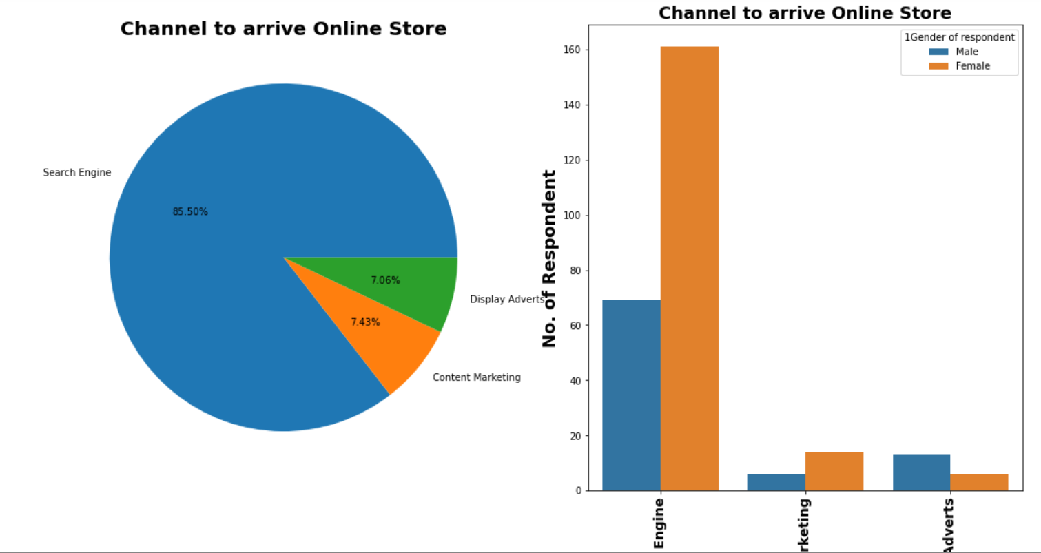
Visualization of Channel to arrive Online Store
Observations:
1. 85.50% respondents use Search Engine channel to arrive at your favorite online store.
2. 7.43% respondents use Content Marketing channel to arrive at your favorite online store.
3. 7.06% respondents use Display Adverts channel to arrive at your favorite online store.

Slide 32
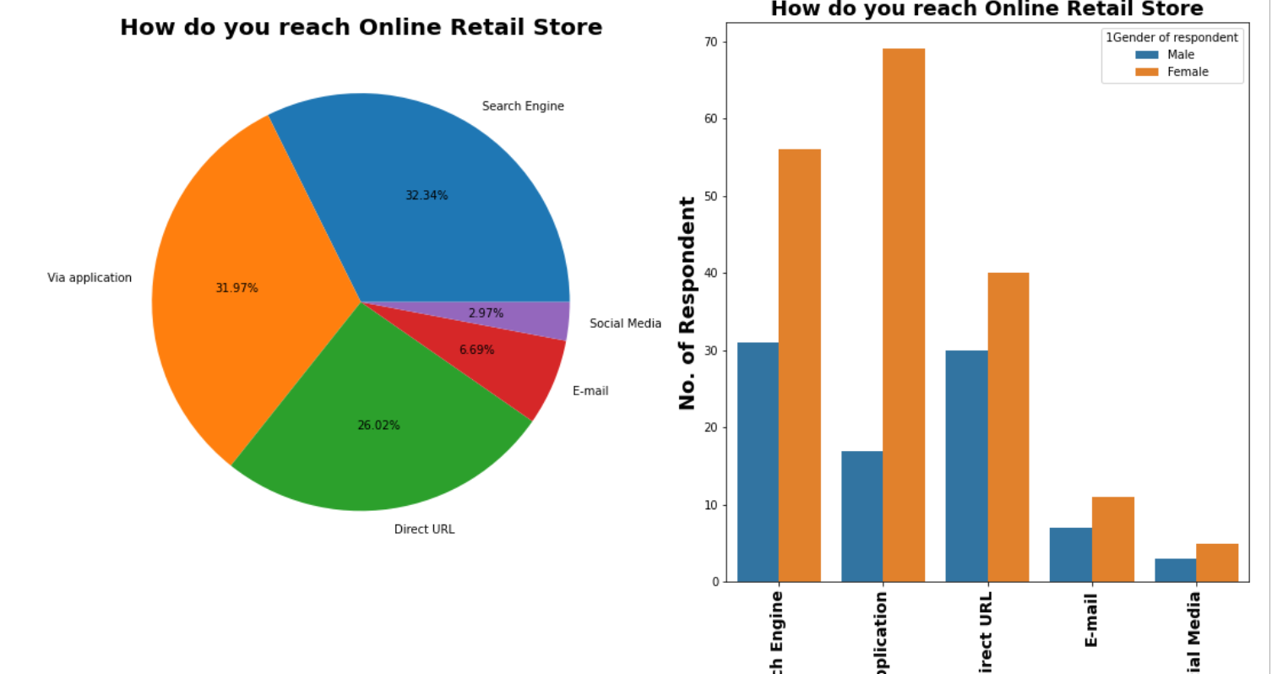
Visualization of How do you reach Online Retail Store
Observations:
1. 32.34% respondents use Search Engine to reach Online Store after first visit.
2. 31.97% respondents reach Online Store Via application after first visit.
3. 26.02% respondents reach Online Store by Direct URL after first visit.
4. 6.69% respondents reach Online Store through E-mail after first visit.
5. 2.97% respondents use Social Media to reach Online Store after first visit.

Slide 33
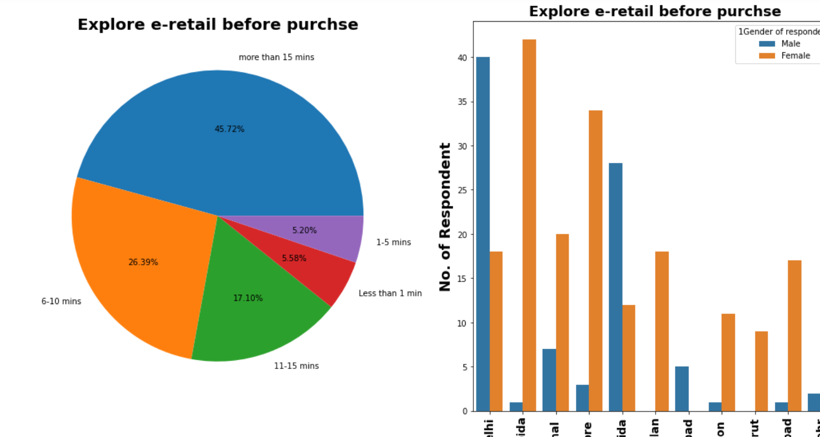
Visualization of Explore e-retail before purchse
Observations:
1. 45.72% respondents take More than 15 minutes to take a purchase decision.
2. 26.39% respondents take 6-10 minutes to take a purchase decision.
3. 17.10% respondents take 11-15 minutes to take a purchase decision.
4. 5.58% respondents take less than 1 min to take a purchase decision.
5. 5.20% respondents take 1-5 minutes to take a purchase decision.

Slide 34
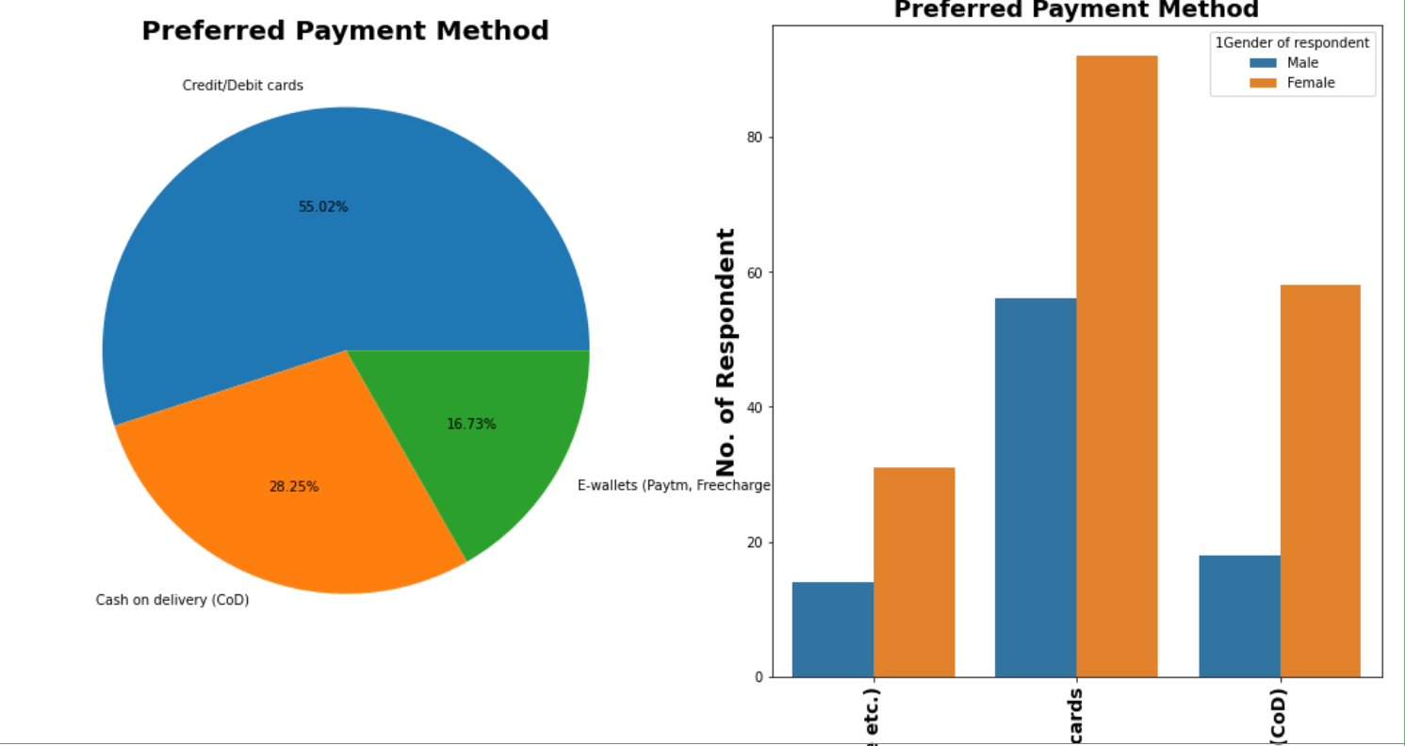
Visualization of Preferred Payment Method
Observations:
1. 55.02% respondents considers using Credit/Debit cards as a preferred payment method.
2. 28.25% respondents choose Cash on Delivery (CoD) as preferred payment method.
3. 16.73% respondents make payment through E-wallets (Paytm, Freecharge etc.)

Slide 35
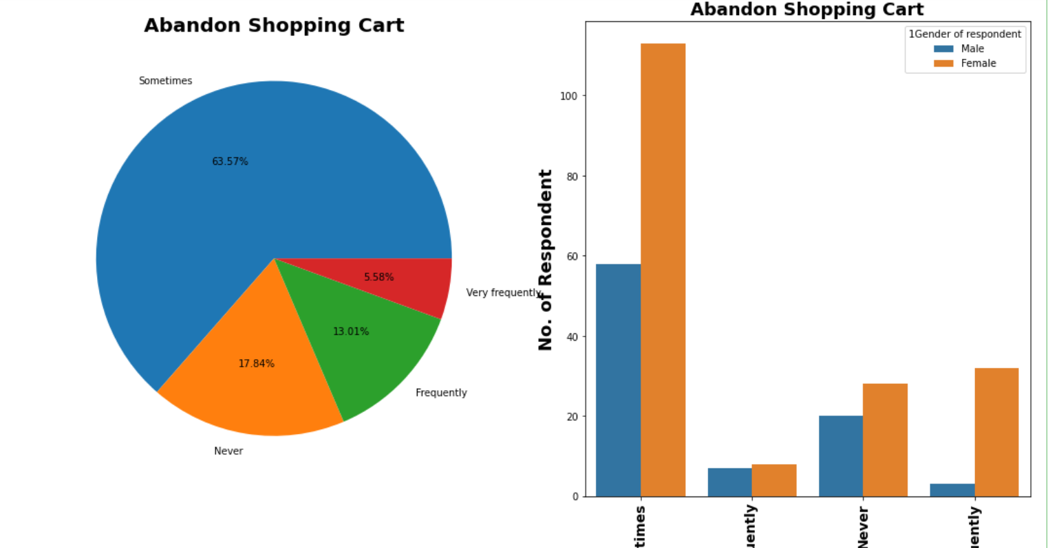
Visualization of Abandon Shopping Cart
Observations:
1. 63.57% respondents abandon their cart sometimes.
2. 17.84% respondents never abandon their cart.
3. 13% respondents abandon their cart Frequently.
4. 5.58% respondents abandon their cart Very Frequently.

Slide 36
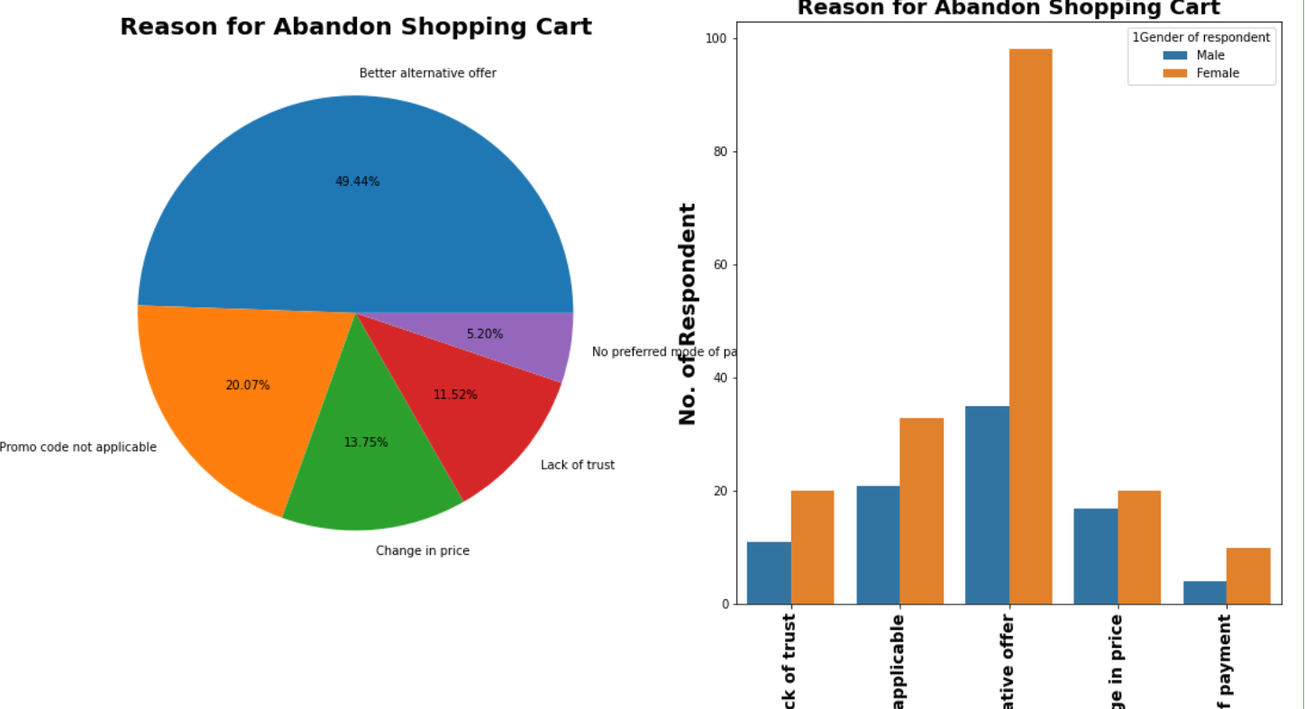
Visualization of Reason for Abandon Shopping Cart
Observations:
1. 50% respondents leave the cart for Better alternative offer.
2. 20% respondents leave the cart because of Promo code not applicable.
3. 13.75% respondents leave the cart due to Change in price.
4. 12% respondents leave the cart for Lack of trust.
5. 5% respondents leave the cart due to No preferred mode of payment.

Slide 37
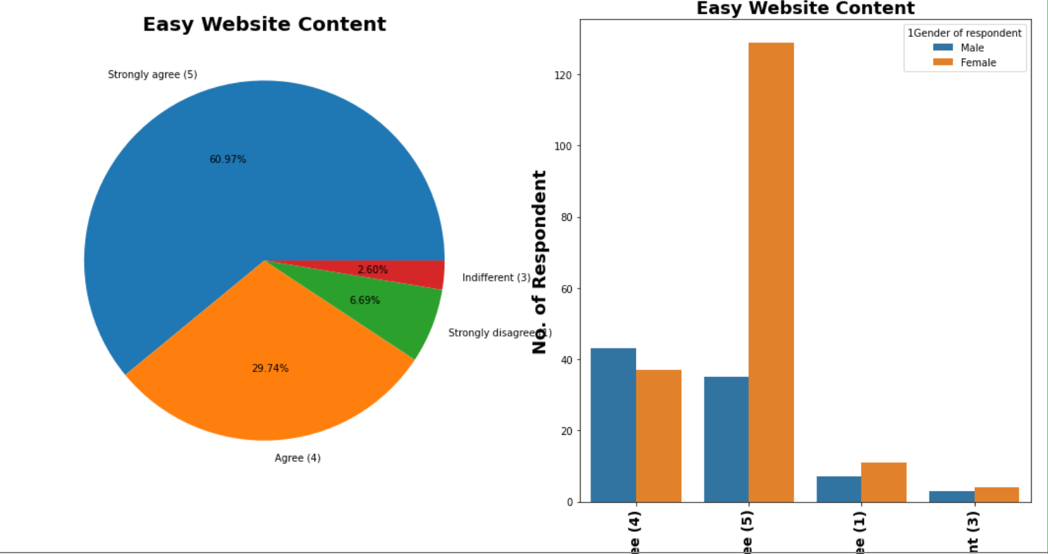
3. Website Usability & performance related feature Visualization of Easy Website Content
Observations:
1. 61% respondents are strongly agreed that The content on the website must be easy to read and understand
2. 30% are agreed that The content on the website must be easy to read and understand
3. 7% respondents are strongly disagreed that The content on the website must be easy to read and understand
4. 2.60% respondents are Indifferent for The content on the website must be easy to read and understand

Slide 38
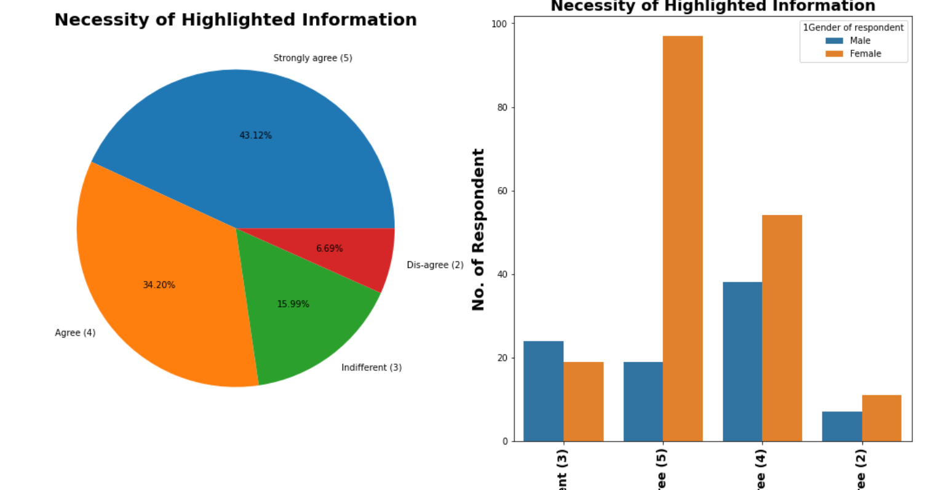
Visualization of Necessity of Highlighted Information
Observations:
1. 43.12% respondents are strongly agreed for Necessity of highlighted information for product comparison
2. 30.20% respondents are agreed for Necessity of highlighted information for product comparison
3. 16% respondents are Indifferent about Necessity of highlighted information for product comparison
4. 6.69% respondents are Dis-agreed for Necessity of highlighted information for product comparison

Slide 39
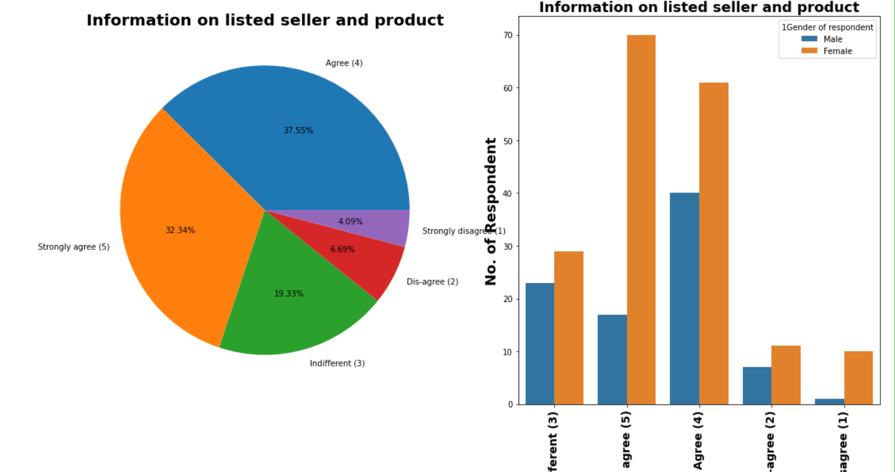
Visualization of Information on listed seller and product
Observations:
1. 37.55% respondents Agreed that Complete information on listed seller and product being offered is important for purchase decision
2. 32.34% respondents strongly Agreed that Complete information on listed seller and product being offered is important for purchase decision
3. 19.33% respondents are Indifferent about their opinoin.
4. 6.69% respondents are dis-agreed on Complete information on listed seller and product being offered is important for purchase decision
5. 4.09% respondents are strongly is-agreed on Complete information on listed seller and product being offered is important for purchase decision

Slide 40
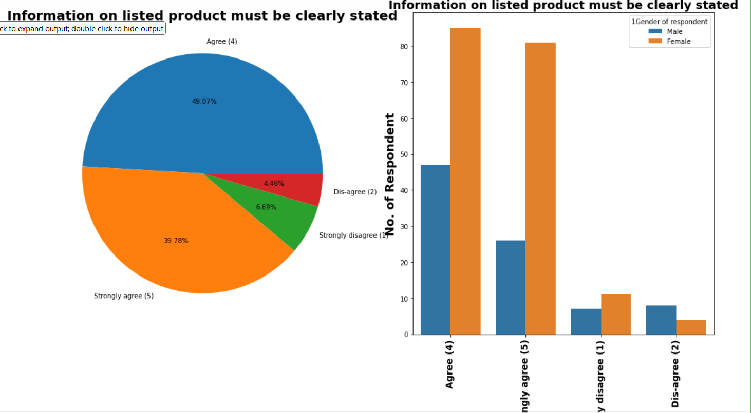
Visualization of Information on listed product must be clearly stated
Observations:
1. 49.07% respondents are agreed that All relevant information on listed products must be stated clearly.
2. 39.78% respondents are strongly agreed that All relevant information on listed products must be stated clearly
3. 6.69% respondents are strongly dis-agreed on All relevant information on listed products must be stated clearly
4. 4.46% respondents are dis-agreed on All relevant information on listed products must be stated clearly

Slide 41
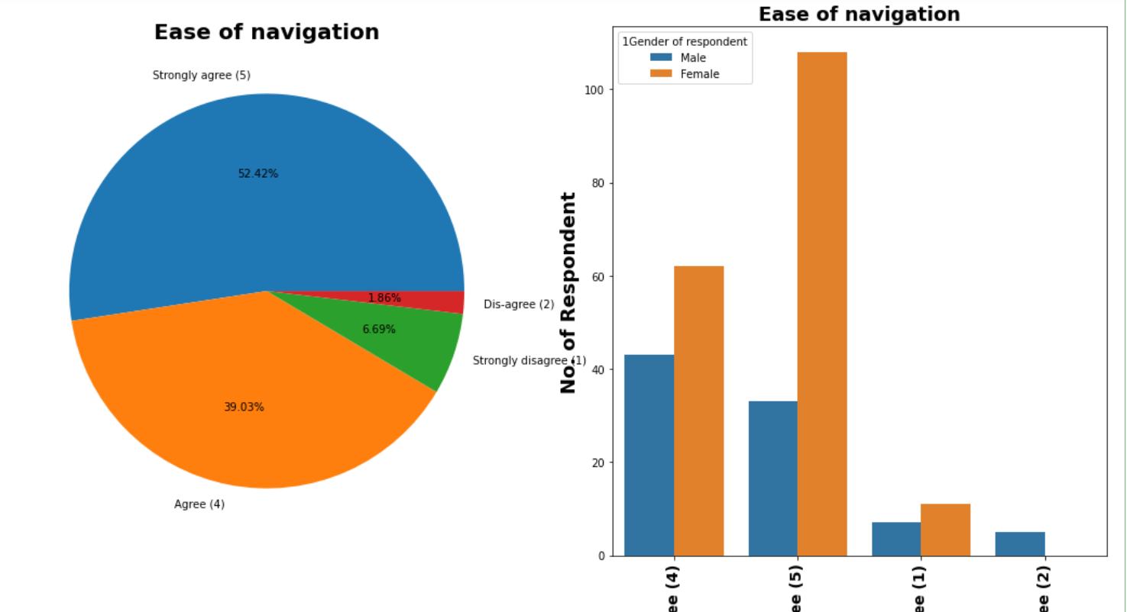
Visualization of Ease of navigation
Observations:
1. 52.42% respondents are strongly agree for Ease of navigation in website.
2. 39% respondents are agree for Ease of navigation in website.
3. 6.69% respondents are strongly disagree for Ease of navigation in website.
4. 1.86% respondents are disagree for Ease of navigation in website.

Slide 42
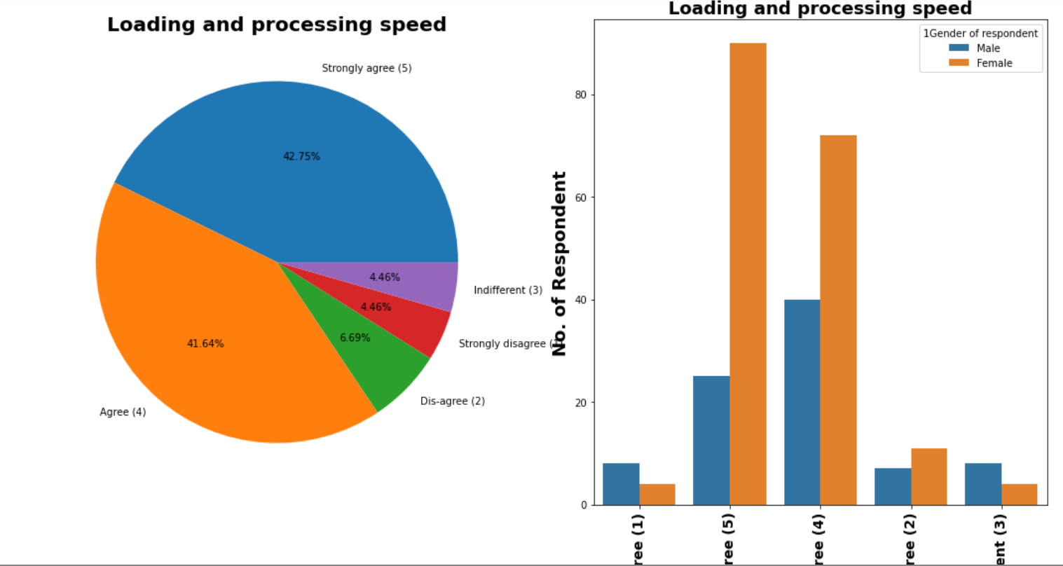
Visualization of Loading and processing speed
Observations:
1. 42.75% respondents are strongly agree for Loading and processing speed.
2. 41.64% respondents are agree for Loading and processing speed.
3. 6.69% respondents are disagree for Loading and processing speed.
4. 4.46% respondents are strongly disagree for Loading and processing speed.
5. 4.46% respondents are Indifferent about their opinion for Loading and processing speed.

Slide 43
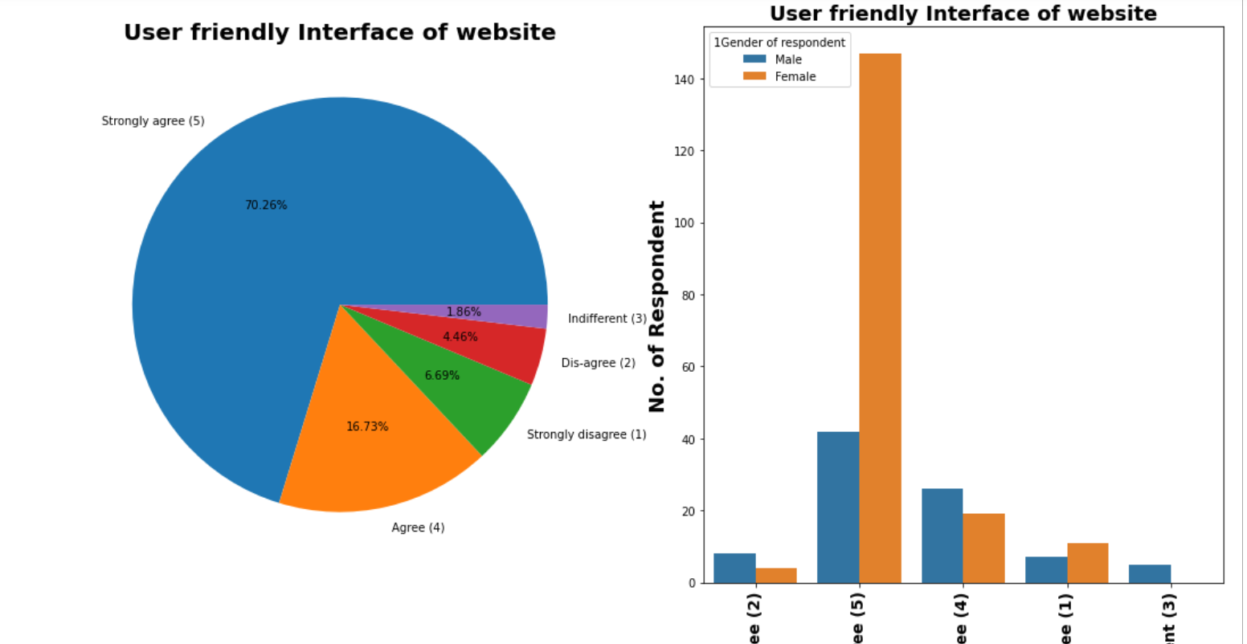
Visualization of User friendly Interface of website
Observations:
1. 70.26% respondents are strongly agree for User friendly Interface of the website.
2. 16.73% respondents are agree for User friendly Interface of the website.
3. 6.69% respondents are strongly disagree for User friendly Interface of the website.
4. 4.46% respondents are disagree for User friendly Interface of the website.
5. 1.86% respondents are Indifferent about their opinion for User friendly Interface of the website.

Slide 44
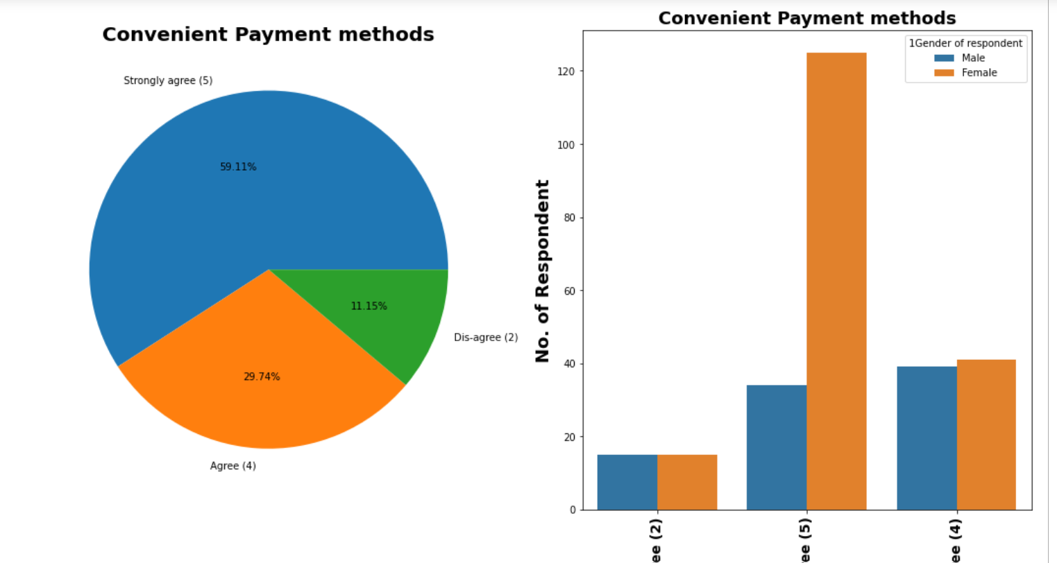
Visualization of Convenient Payment methods
Observations:
1. 59.11% respondents are strongly agree for Convenient Payment methods.
2. 29.74% respondents are agree for Convenient Payment methods.
3. 11.15% respondents are disagree for Convenient Payment methods.

Slide 45
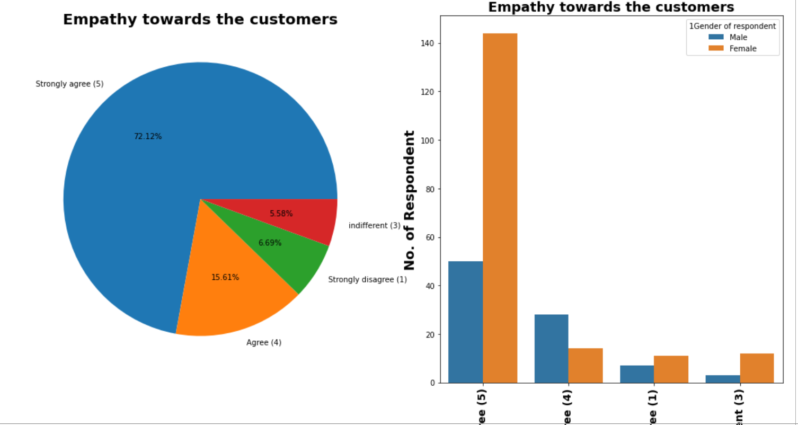
4. Customer Service Requirement Related Features Visualization of Empathy towards the customers
Observations:
1. 72.12% respondents are strongly agree for Empathy (readiness to assist with queries) towards the customers.
2. 15.61% respondents are agree for Empathy (readiness to assist with queries) towards the customers.
3. 6.69% respondents are strongly disagree for Empathy (readiness to assist with queries) towards the customers.
4. 5.58% respondents are indifferent about their opinion for Empathy (readiness to assist with queries) towards the customers.

Slide 46
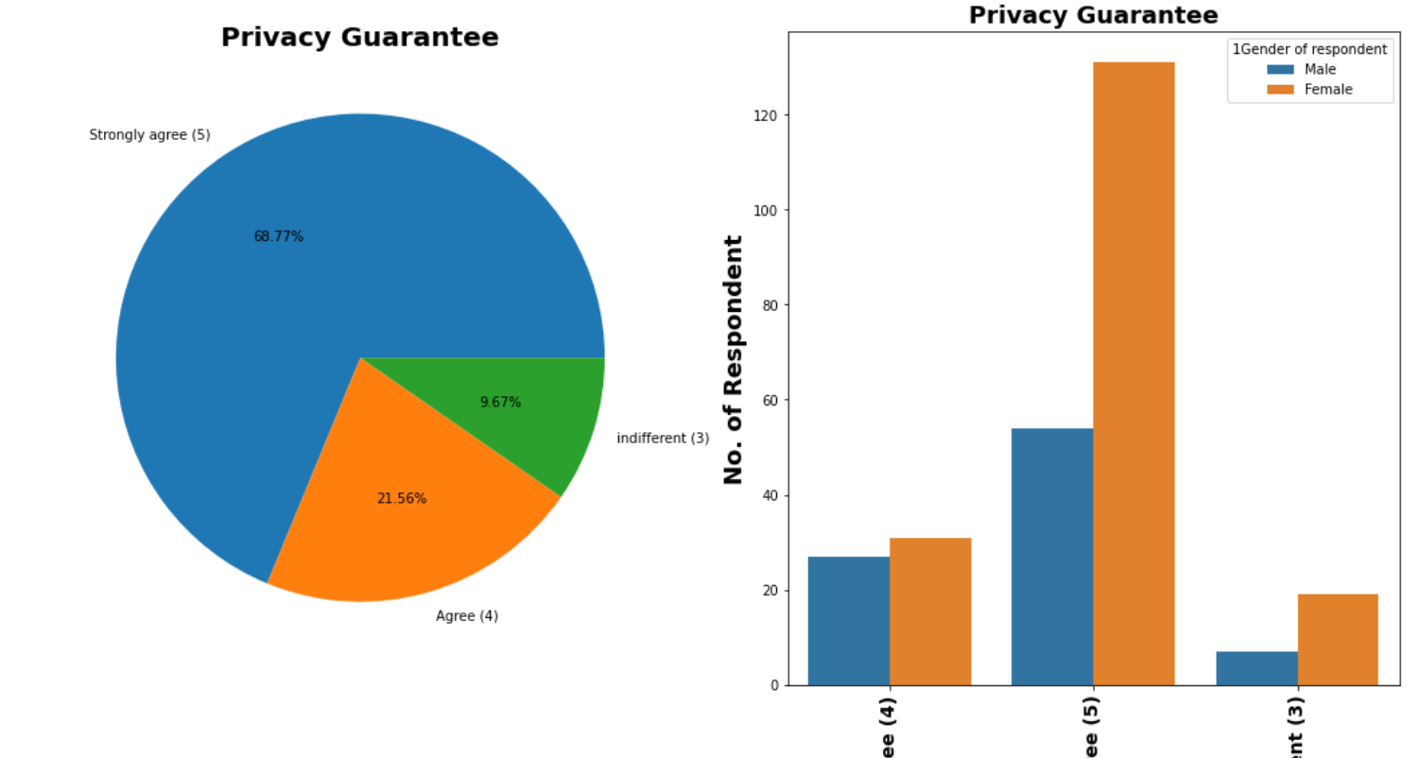
Visualization of Privacy Guarantee
Observations:
1. 68.77% respondents strongly agreed on Being able to guarantee the privacy of the customer.
2. 21.56% respondents agreed on Being able to guarantee the privacy of the customer.
3. 9.67% respondents are indifferent about their opinion on Being able to guarantee the privacy of the customer.

Slide 47
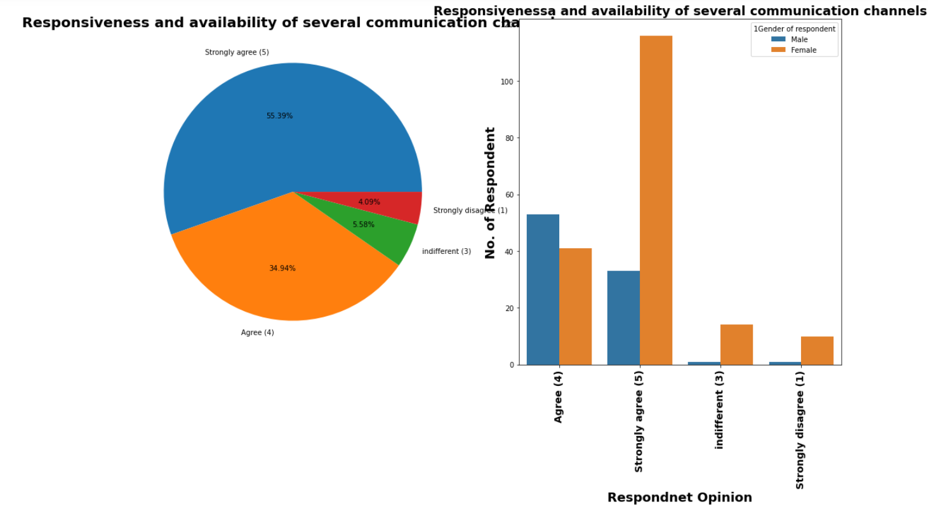
Visualization of Responsiveness and availability of several communication channels
Observations:
1. 55.39% respondents strongly agreed on Responsiveness, availability of several communication channels.
2. 34.94% respondents agreed on Responsiveness, availability of several communication channels.
3. 5.58% respondents are indifferent about their opinion on Responsiveness, availability of several communication channels.
4. 4.09% respondents strongly dis-agreed on Responsiveness, availability of several communication channels.

Slide 48
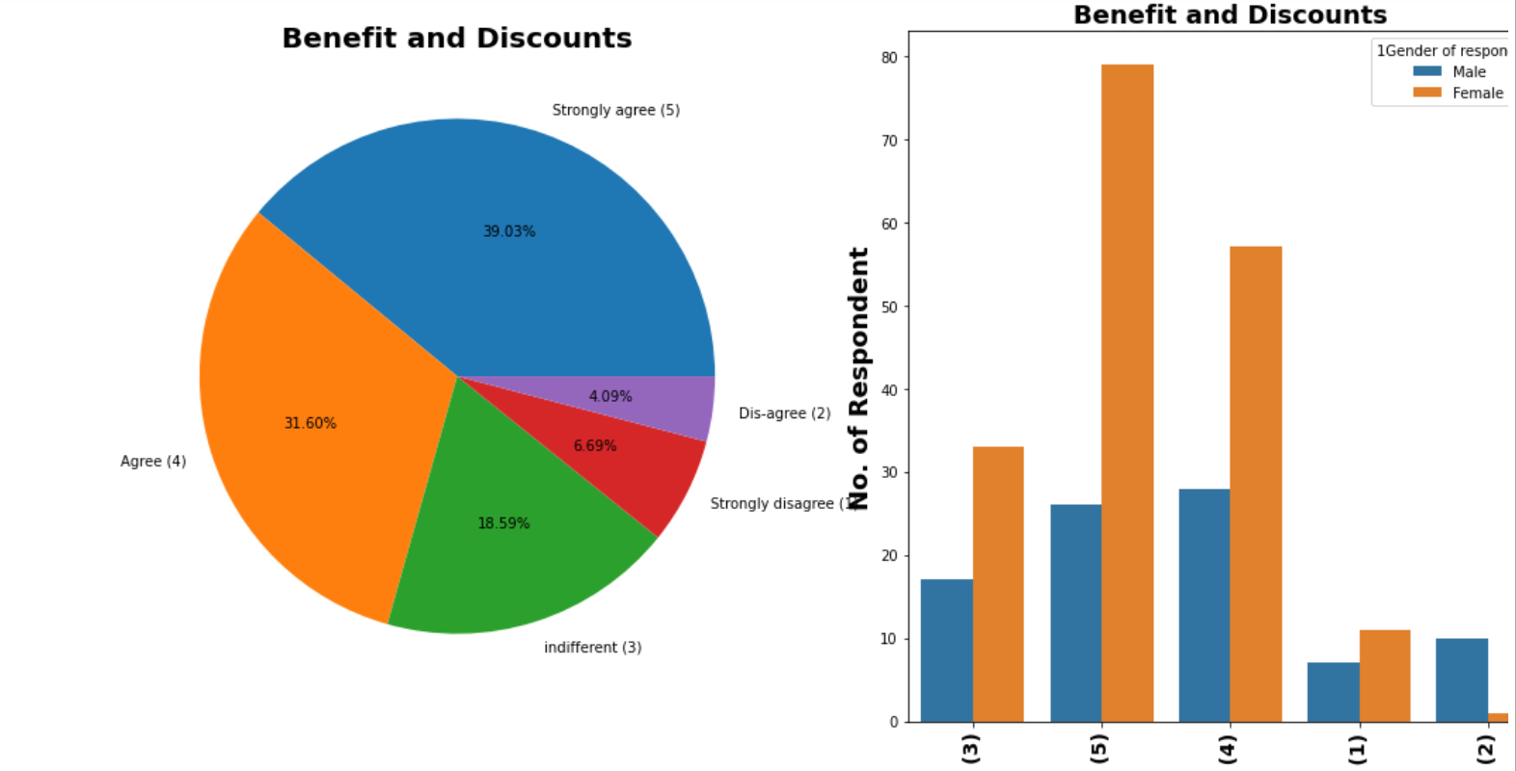
Visualization of Benefit and Discounts
Observations:
1. 39.03% respondents strongly agreed that Online shopping gives monetary benefit and discounts.
2. 31.60% respondents agreed Online shopping gives monetary benefit and discounts.
3. 18.59% respondents are indifferent about their opinion that Online shopping gives monetary benefit and discounts.
4. 6.69% respondents strongly dis-agreed that Online shopping gives monetary benefit and discounts.
5. 4.09 % respondents dis-agreed that Online shopping gives monetary benefit and discounts.

Slide 49
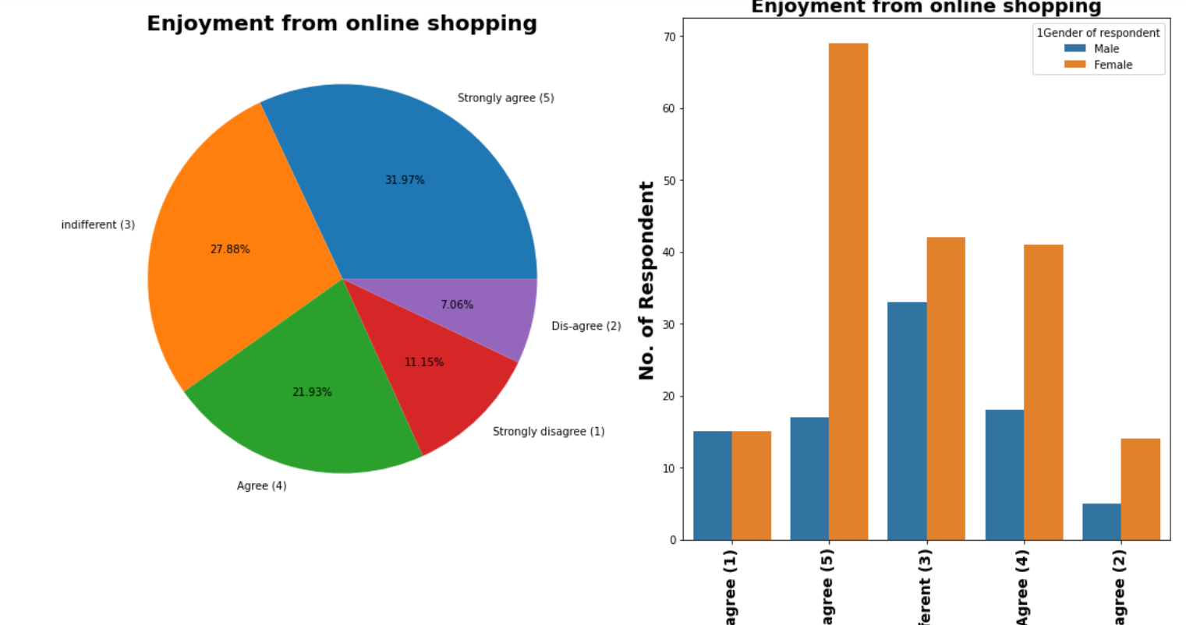
Visualization of Enjoyment from online shopping
Observations:
1. 31.97% respondents strongly agreed that Enjoyment is derived from shopping online.
2. 27.88% respondents are indifferent about their opinion that Enjoyment is derived from shopping online.
3. 21.93% respondents agreed that Enjoyment is derived from shopping online..
4. 11.15% respondents strongly dis-agreed that Enjoyment is derived from shopping online..
5. 7.06 % respondents dis-agreed that Enjoyment is derived from shopping online..

Slide 50
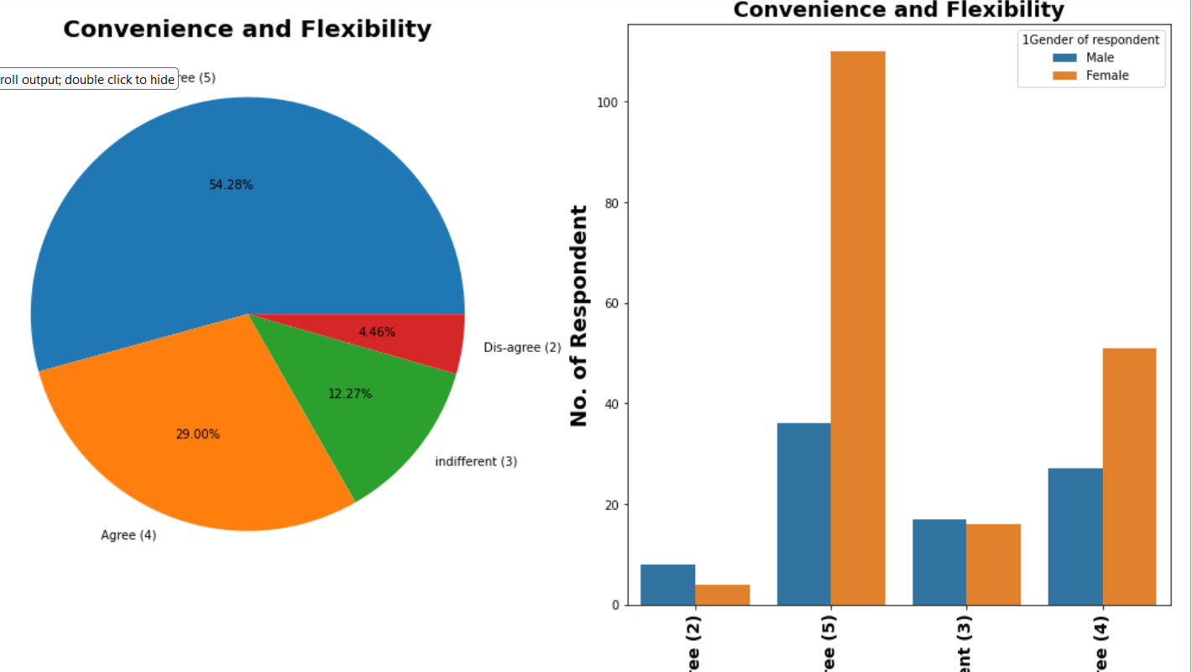
Visualization of Convenience and Flexibility
Observations:
1. 54.28% respondents strongly agreed that Online Shopping is convenient and flexible.
2. 29% respondents agreed that Online Shopping is convenient and flexible.
3. 12.27% respondents are infifferent about their opinion that Online Shopping is convenient and flexible.
4. 4.46% respondents dis-agreed that Online Shopping is convenient and flexible.

Slide 51
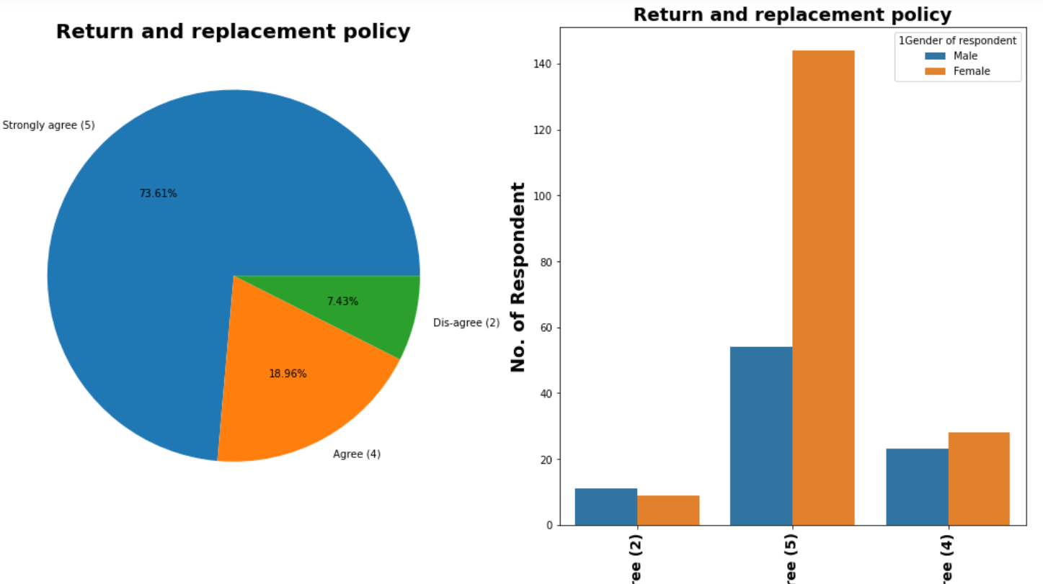
Visualization of Return and replacement policy
Observations:
1. 73.61% respondents strongly agreed that Return and replacement policy of the e-tailer is important for purchase decision.
2. 18.96% respondents agreed that Return and replacement policy of the e-tailer is important for purchase decision.
3. 7.43% respondents dis-agreed that Return and replacement policy of the e-tailer is important for purchase decision.

Slide 52
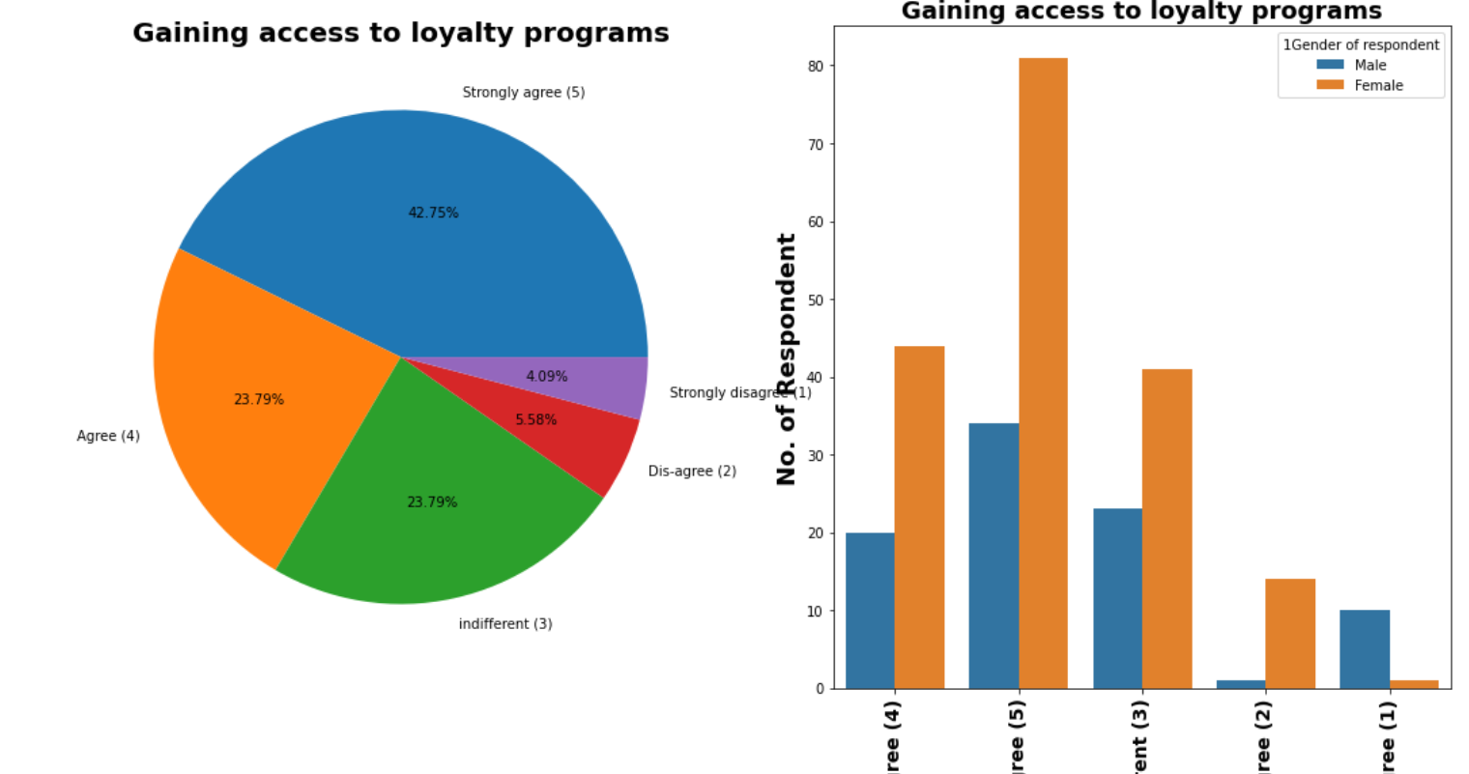
Visualization of Gaining access to loyalty programs
Observations:
1. 42.75% respondents strongly agreed that Gaining access to loyalty programs is a benefit of shopping online.
2. 23.79% respondents agreed that Gaining access to loyalty programs is a benefit of shopping online.
3. 4.09% respondents strongly dis-agreed that Gaining access to loyalty programs is a benefit of shopping online.
4. 5.58% respondents dis-agreed that Gaining access to loyalty programs is a benefit of shopping online.
5. 23.79% respondents are indifferent abput their opinion that Gaining access to loyalty programs is a benefit of shopping online.

Slide 53
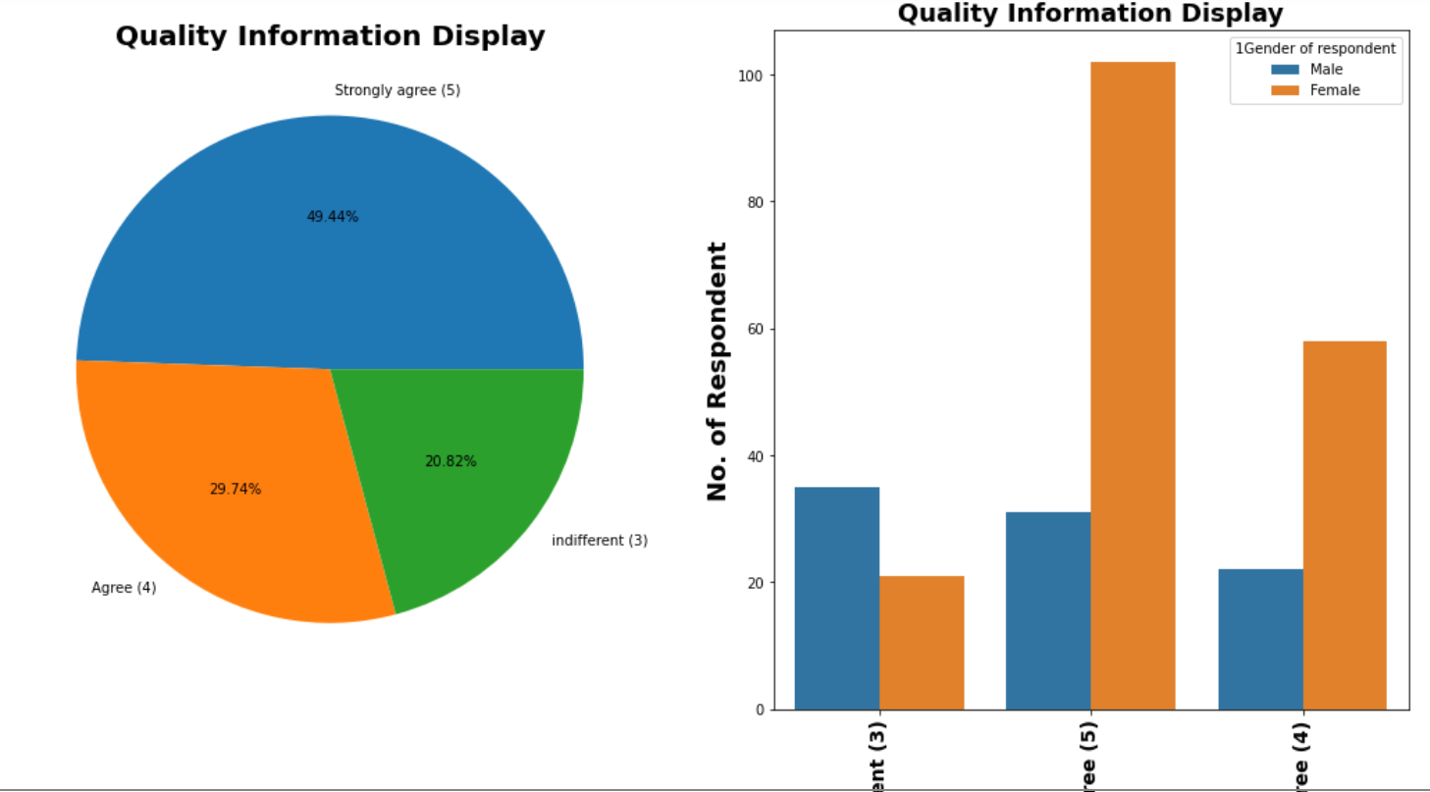
Visualization of Quality Information Display
Observations:
1. 49.44% respondents strongly agreed that Displaying quality Information on the website improves satisfaction of customers.
2. 29.74% respondents agreed that Displaying quality Information on the website improves satisfaction of customers.
3. 20.82% respondents are indifferent abput their opinion that Displaying quality Information on the website improves satisfaction of customers.

Slide 54
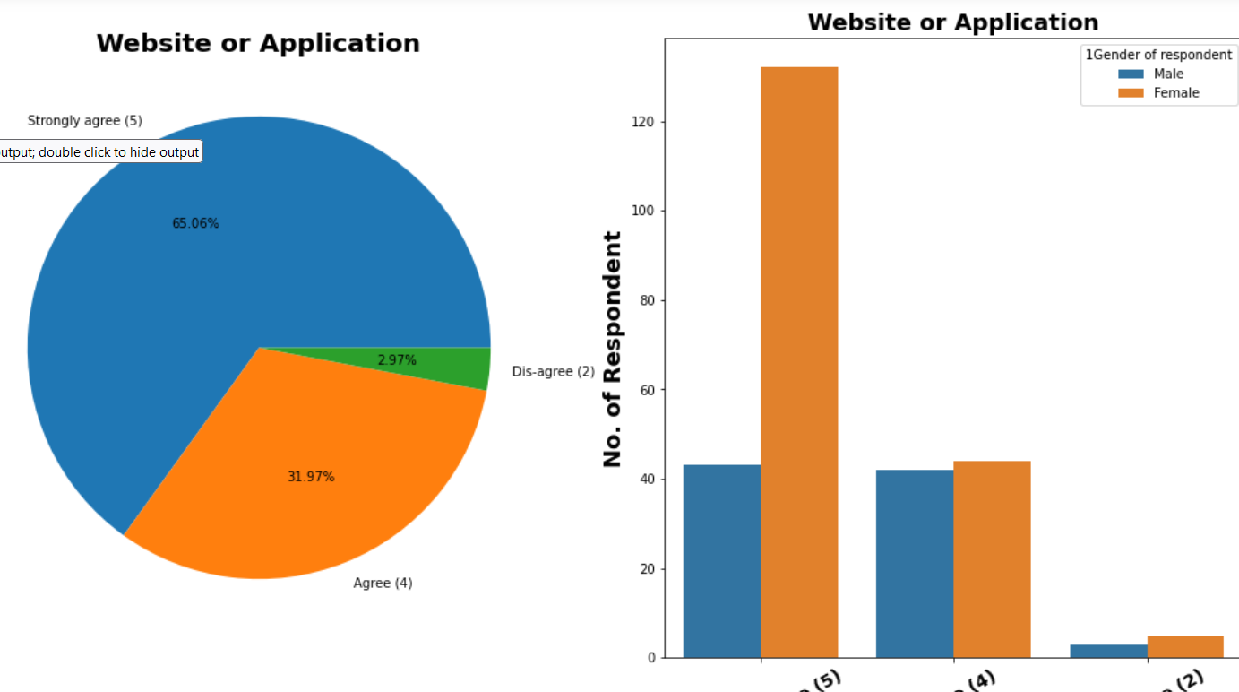
Visualization of Website or Application
Observations:
1. 65% respondents strongly agreed that User derive satisfaction while shopping on a good quality website or application.
2. 32% respondents agreed that User derive satisfaction while shopping on a good quality website or application.
3. 3% respondents dis-agreed that User derive satisfaction while shopping on a good quality website or application.

Slide 55
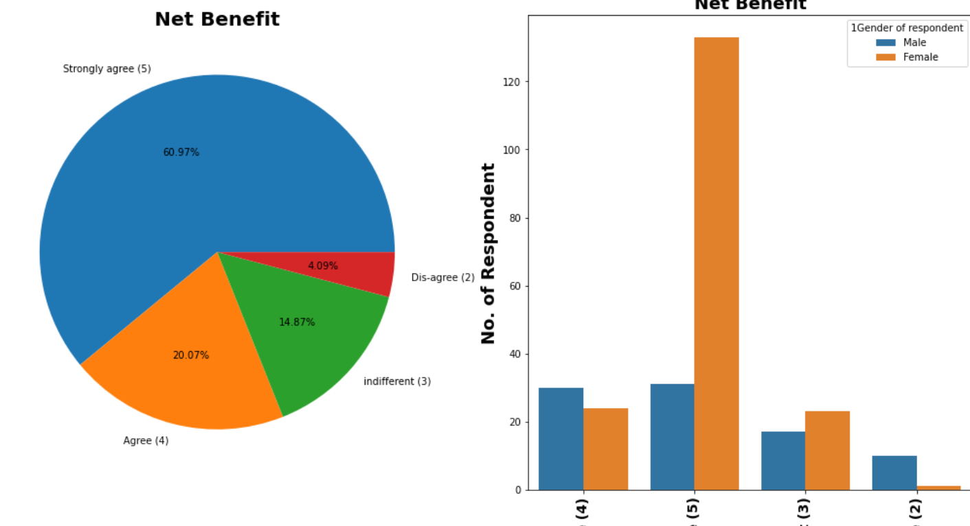
Visualization of Net Benefit
Observations:
1. 61% respondents strongly agreed that Net Benefit derived from shopping online can lead to users satisfaction.
2. 20% respondents agreed that Net Benefit derived from shopping online can lead to users satisfaction.
3. 4% respondents dis-agreed that Net Benefit derived from shopping online can lead to users satisfaction.
4. 15% respondents are indifferent about their opinion that Net Benefit derived from shopping online can lead to users satisfaction.

Slide 56
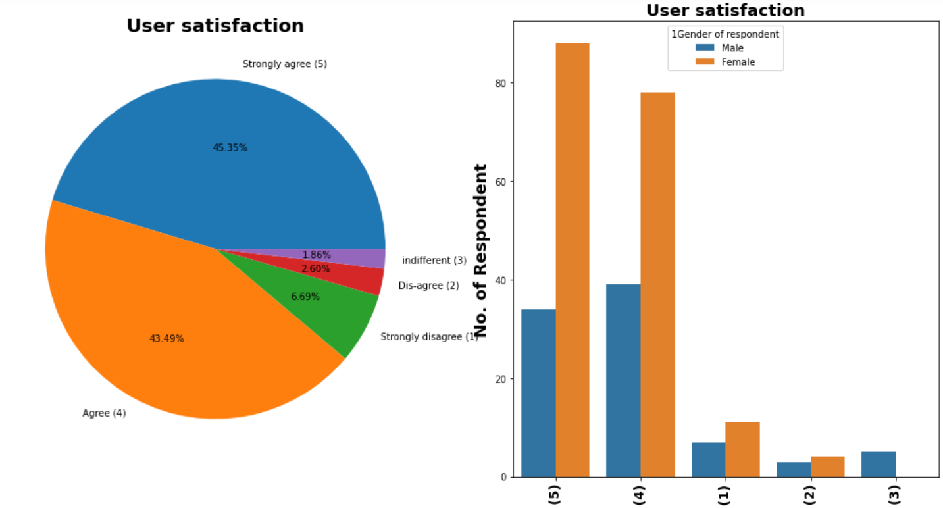
Visualization of User satisfaction
Observations:
1. 45.35% respondents strongly agreed that User satisfaction cannot exist without trust.
2. 43.49% respondents agreed that User satisfaction cannot exist without trust.
3. 6.69% respondents strongly dis-agreed that User satisfaction cannot exist without trust.
4. 2.60% respondents dis-agreed that User satisfaction cannot exist without trust.
5. 1.86% respondents are indifferent abput their opinion that User satisfaction cannot exist without trust.

Slide 57
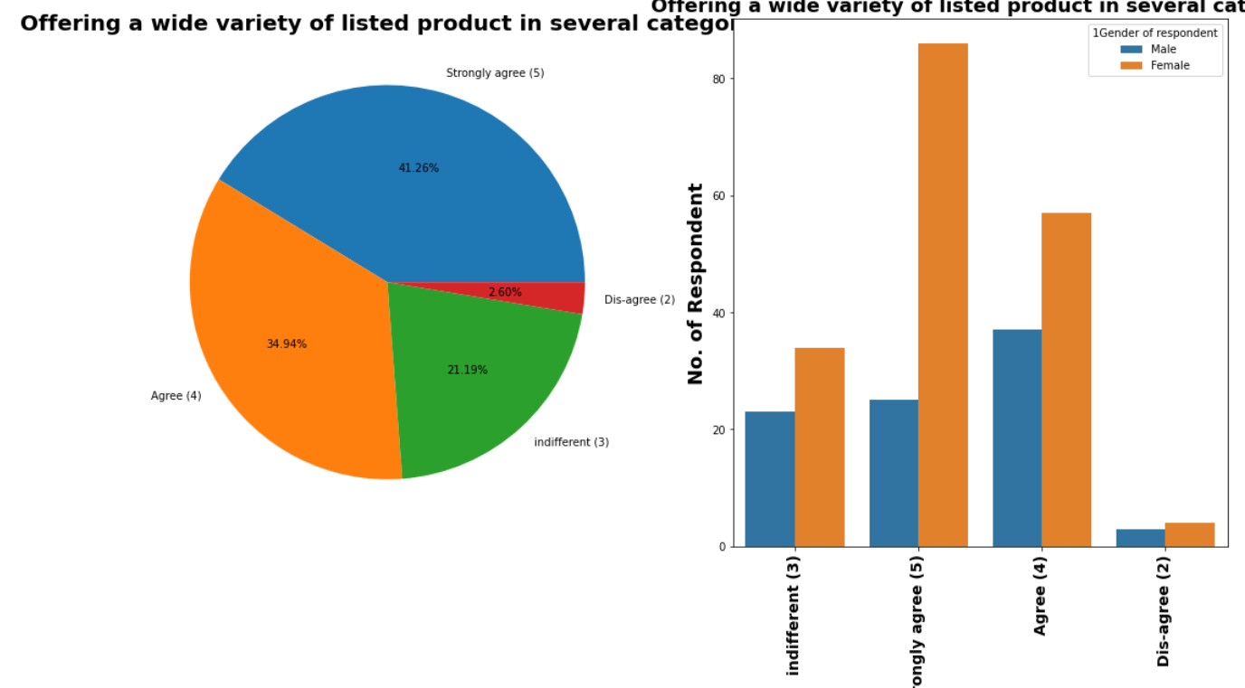
5. Features related to Customer online shopping experiences Visualization of Offering a wide variety of listed product in several category
Observations:
1. 41.26% respondents strongly agreed on Offering a wide variety of listed product in several category.
2. 34.94% respondents agreed on Offering a wide variety of listed product in several category.
3. 2.60% respondents dis-agreed on Offering a wide variety of listed product in several category.
4. 21.96% respondents are indifferent abput their opinion on Offering a wide variety of listed product in several category.

Slide 58
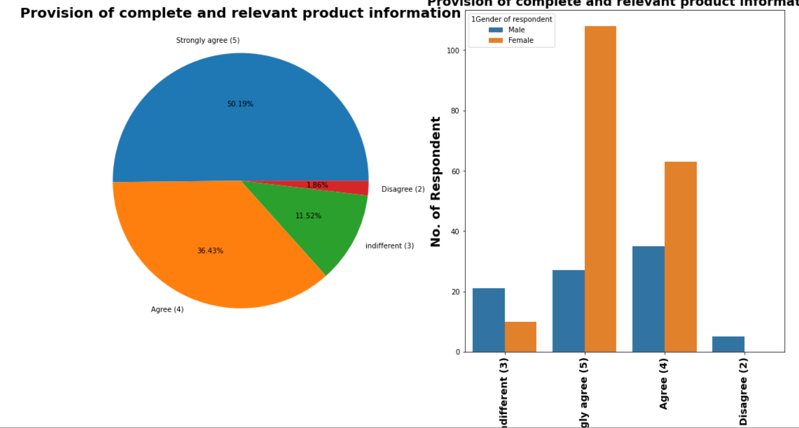
Visualization of Provision of complete and relevant product information
Observations:
1. 50.19% respondents strongly agreed for Provision of complete and relevant product information.
2. 36.43% respondents agreed for Provision of complete and relevant product information.
3. 1.86% respondents dis-agreed for Provision of complete and relevant product information.
4. 11.52% respondents are indifferent abput their opinion for Provision of complete and relevant product information.

Slide 59
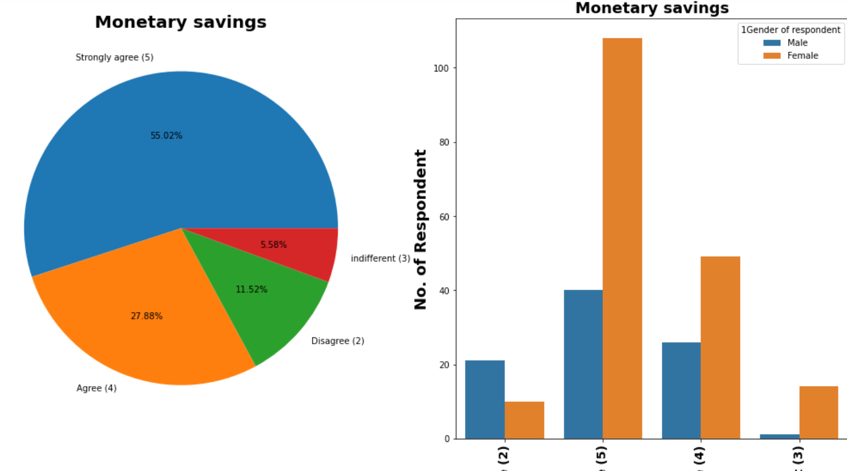
Visualization of Monetary savings
Observations:
1. 55% respondents strongly agreed for Monetary savings.
2. 28% respondents agreed for Monetary savings.
3. 11.52% respondents dis-agreed for Monetary savings.
4. 5.58% respondents are indifferent abput their opinion for Monetary savings.

Slide 60
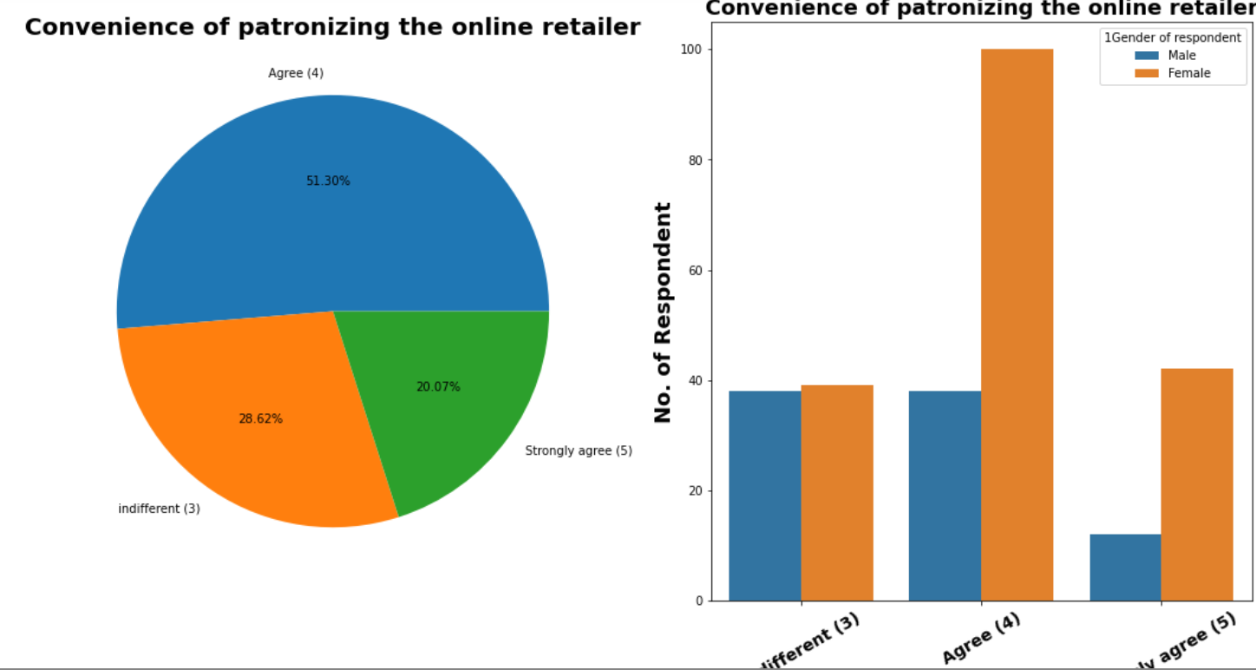
Visualization of Convenience of patronizing the online retailer
Observations:
1. 20.07% respondents strongly agreed for The Convenience of patronizing the online retailer.
2. 51.30% respondents agreed for The Convenience of patronizing the online retailer.
3. 28.62% respondents are indifferent abput their opinion for The Convenience of patronizing the online retailer.

Slide 61
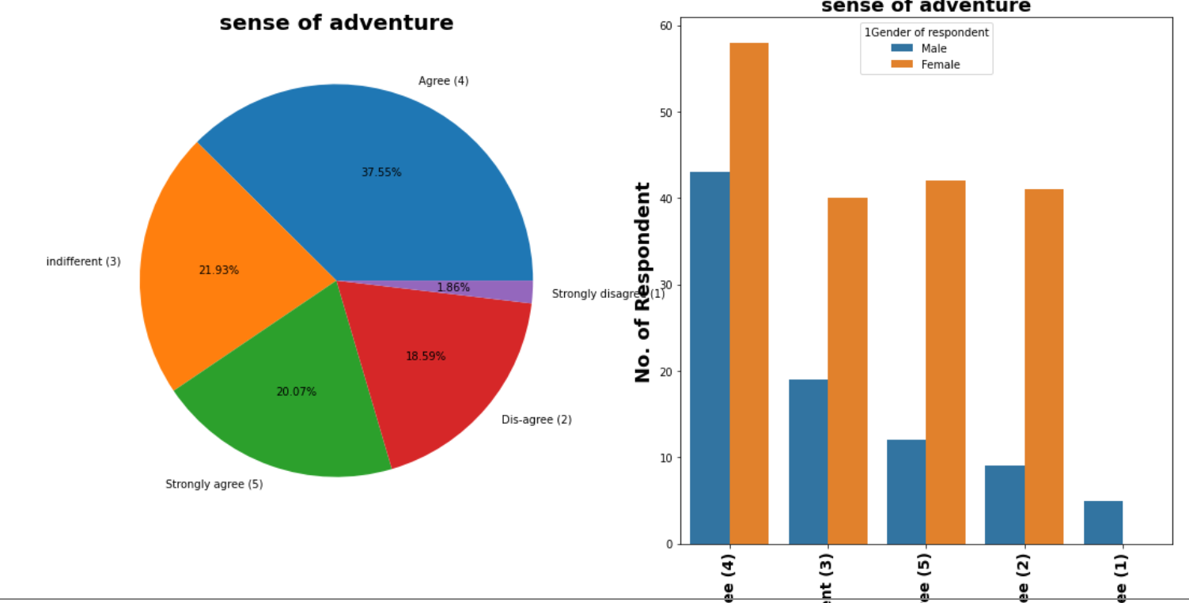
Visualization of sense of adventure
Observations:
1. 20.07% respondents strongly agreed that Shopping on the website gives you the sense of adventure.
2. 37.55% respondents agreed that Shopping on the website gives you the sense of adventure.
3. 21.93% respondents are indifferent abput their opinion that Shopping on the website gives you the sense of adventure.
4. 1.86% respondents strongly dis-agreed that Shopping on the website gives you the sense of adventure.
5. 18.59% respondents dis-agreed that Shopping on the website gives you the sense of adventure.

Slide 62
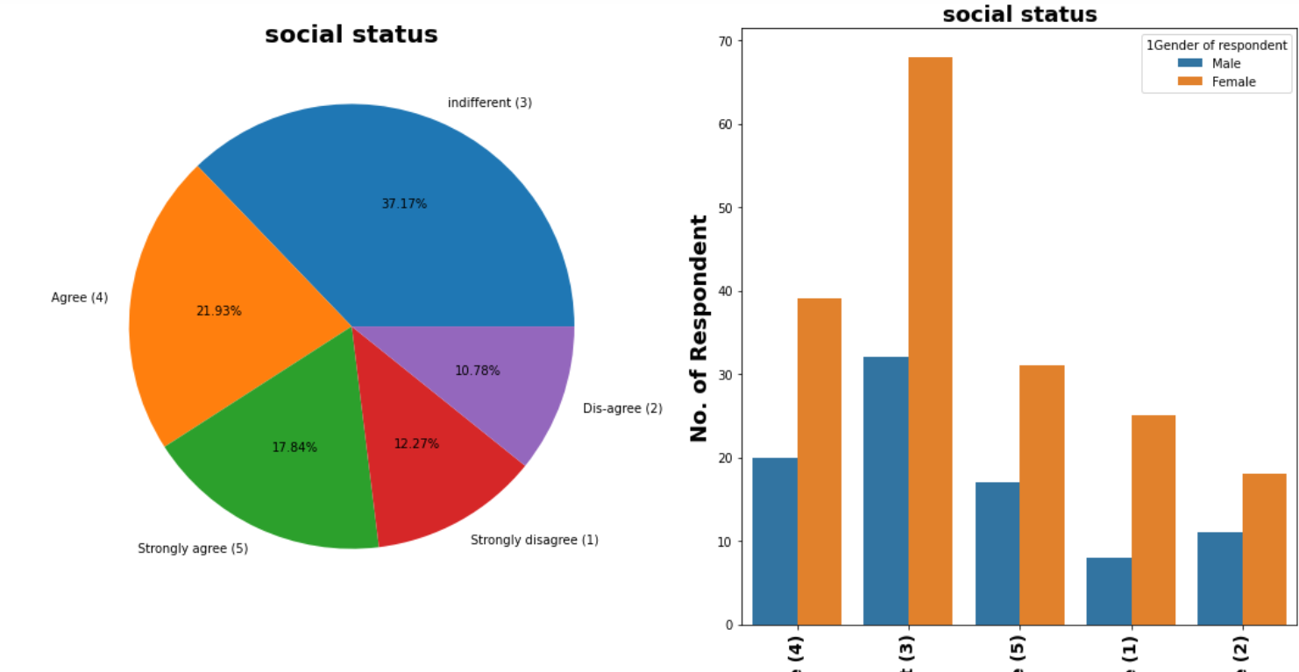
Visualization of social status
Observations:
1. 17.84% respondents strongly agreed that Shopping on your preferred e-tailer enhances your social status.
2. 21.93% respondents agreed that Shopping on your preferred e-tailer enhances your social status.
3. 37.17% respondents are indifferent abput their opinion that Shopping on your preferred e-tailer enhances your social status.
4. 12.27% respondents strongly dis-agreed that Shopping on your preferred e-tailer enhances your social status.
5. 10.78% respondents dis-agreed that Shopping on your preferred e-tailer enhances your social status.

Slide 63
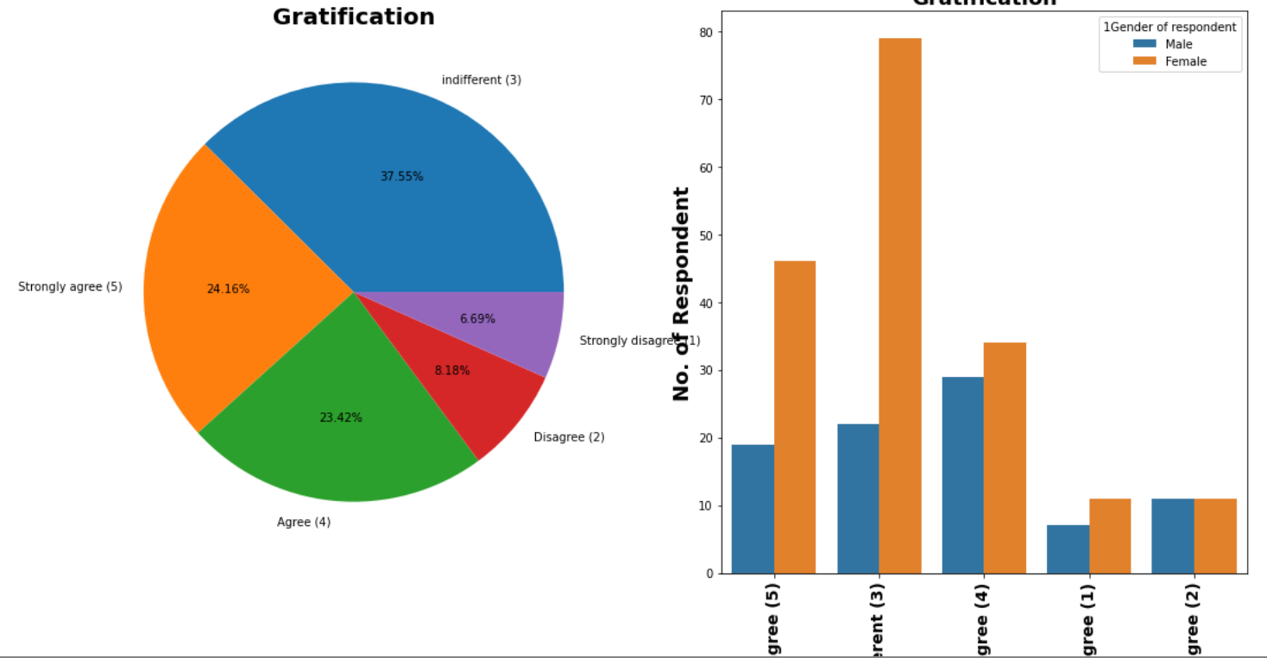
Visualization of Gratification
Observations:
1. 24.16% respondents strongly agreed that they feel gratification shopping on their favorite e-tailer.
2. 23.42% respondents agreed that they feel gratification shopping on their favorite e-tailer.
3. 37.55% respondents are indifferent abput their opinion that they feel gratification shopping on their favorite e-tailer.
4. 6.69% respondents strongly dis-agreed that they feel gratification shopping on their favorite e-tailer.
5. 8.18% respondents dis-agreed that they feel gratification shopping on their favorite e-tailer.

Slide 64
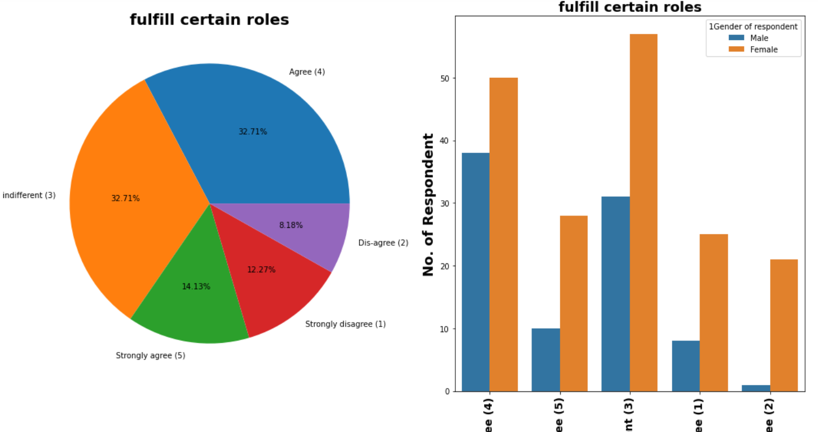
Visualization of fulfill certain roles
Observations:
1. 14.13% respondents strongly agreed that Shopping on the website helps you fulfill certain roles.
2. 32.71% respondents agreed that Shopping on the website helps you fulfill certain roles.
3. 32.71% respondents are indifferent abput their opinion that Shopping on the website helps you fulfill certain roles.
4. 12.27% respondents strongly dis-agreed that Shopping on the website helps you fulfill certain roles.
5. 8.18% respondents dis-agreed that Shopping on the website helps you fulfill certain roles.

Slide 65

Visualization of Getting value for money spent
Observations:
1. 30.48% respondents strongly agreed for Getting value for money spent.
2. 55.39% respondents agreed for Getting value for money spent.
3. 14.13% respondents are indifferent abput their opinion for Getting value for money spent.

Slide 66




Opinion on Online Shopping Platform Websites by Customer

Slide 67





Slide 68

Observation:
1. Majority customers agree that Amazon.in, Flipkart.com, Paytm.com, Myntra.com, Snapdeal.com are Easy to use website or application. But Overall if we look at countplot of easy to use application & website Amazon.in got individually 1st Rank.
2. 87 customers agree that Amazon.in, Flipkart.com have Visual appealing web-page layout than most of other market players.
3. Around according to 125 people Amazon.in, Flipkart.com provides wide varity of offer on product.

Slide 69
4. We already know 50.2% Strongly agree over providing complete relevalent product information, and here we can see that 100 customer think that Amazon.in, Flipkart.com provides complete information compare to others.
5. Previously we know that 42.8 % customer strongly agree and 41.6 % customer agree over high loading & processing speed of website.Here we can see Majority of people think that loading speed of Amazon.in is fastest while Flipkart.com slowest website to load.
6. In terms of Reliability of website or application again Amazon top list.
7. Majority of people also think that Amazon.in tops the chart in terms of quickness purchase process compare to others.
8. Majority of customers think that Amazon.in, Flipkart.com provides several payment options compare to others.
9. Safe & Speed delivery very much deciding factor in terms of purchase. In terms of speed of delivery Amazon.in is much better than other online shopping platform and Flipkart.com worst among all in terms of speed delivery of product.

Slide 70


Privacy & Security Related Features

Slide 71





Slide 72





Slide 73





Slide 74
Observations
1. We already Know more than 90% Customer thinks that gaurantee on privacy of thier information is important for them.Majority of customers trust Amazon.in more than other shopping platform for Privacy of customers’ information
2. Majority of customer trust Amazon.in followed by Flipkart.in over Security of thier financial information.We also see very few peoples trust payment platform paytm.
3. Amazon.in, Flipkart.com, Myntra.com, Snapdeal.com provide assistance through different multi channel.
4. Longer time to get logged in can annoyed customer. *Amazon.in take longer time to logged in while Flipkart.com take least time among all*.
5. Majority of people agree that Amazon.in, Flipkart.com takes longer time in displaying and photos.
6. Myntra.com followed by Paytm.com take longer page loading time.
7. Most of people want shorter delivery time frame, majority customer agree that Paytm.com takes longest time for delivery compare to others.
8. Amazon.in website is as effient as ealier after updation.
9. Majority 80 peoples recommanded Amazon.in to their friends.

Slide 75
On analysing above features following key finding:
Observations:
Majority, 64 customers agreed that Amazon, Flipkart, Paytm, Myntra and Snapdeal are easy to use websites or applications but by observing countplot of ‘easy to use application & website’ it is clear that Amazon got 1st rank.
87 customers agree that Amazon.in, Flipkart.com have Visual appealing web-page layout than most of other market players.
Around according to 125 people Amazon.in, Flipkart.com provides wide variety of offer on product.
We already know 50.2% Strongly agree over providing complete relevant product information, and here we can see that 100 customer think that Amazon.in, Flipkart.com provides complete information compare to others.
Previously we know that 42.8 % customer strongly agree and 41.6 % customer agree over high loading & processing speed of website. Here we can see Majority of people think that loading speed of Amazon.in is fastest while Flipkart.com slowest website to load.
In terms of Reliability of website or application again Amazon top list.
Majority of people also think that Amazon.in tops the chart in terms of quickness purchase process compare to others.
Majority of customers think that Amazon.in, Flipkart.com provides several payment options compare to others.
Safe & Speed delivery very much deciding factor in terms of purchase. In terms of speed of delivery Amazon.in is much better than other online shopping platform and Flipkart.com worst among all in terms of speed delivery of product.
We already Know more than 90% Customer thinks that guarantee on privacy of their information is important for them. Majority of customers trust Amazon.in more than other shopping platform for Privacy of customers’ information.

Slide 76
Majority of customer trust Amazon.in followed by Flipkart.in over Security of their financial information. We also see very few peoples trust payment platform Paytm.
Amazon.in, Flipkart.com, Myntra.com, Snapdeal.com provide assistance through different multi-channel.
Longer time to get logged in can annoyed customer. Amazon.in take longer time to logged in while Flipkart.com take least time among all.
Majority of people agree that Amazon.in, Flipkart.com takes longer time in displaying and photos.
Myntra.com followed by Paytm.com take longer page loading time.
Most of people want shorter delivery time frame, majority customer agree that Paytm.com takes longest time for delivery compare to others.
Amazon.in website is as efficient as earlier after upgradation.
Majority 80 peoples recommended Amazon.in to their friends.
Based on analysis we have following recommendation for E-commerce companies
Amazon.com
Areas for further improvement:
During promotions, try to give a disturbance free shopping experience to customers.
Give more payment options to customers.
Try to give price early during promotion.
Strong Area according to feedback by customer:
Convenient to use and also a good website for shopping.
Fast delivery of products.
Availability of complete information of the products.
Presence of online assistance through multi-channels.
Reliable website or app, perceived trustworthiness.

Slide 77
2. Flipkart.com
Areas for further improvement:
During promotions, try to give a disturbance free shopping experience to customers.
Give more payment options to customers.
Try to give the price early during promotion.
Reduce the delivery time of the products.
Flipkart and Amazon almost share the same feedbacks with varying percentages as the only difference.
Strong Area according to feedback by customer:
Convenient to use and also a good website for shopping.
Fast delivery of products.
Availability of complete information of the products.
Presence of online assistance through multi-channels.
Reliable website or app, perceived trustworthiness.
Wild variety of products to offer.
3. Myntra.com
Areas for further improvement:
During promotions, try to give a disturbance free shopping experience to customers.
Try to give the price early during promotions.
Reduce the delivery time of the products during promotions.

Slide 78
Strong Area according to feedback by customer:
Convenient to use and also a good website.
Availability of several payment options.
Faster products delivery.
Complete information of products available.
Reliable website or app, perceived trustworthiness.
Wide variety of product to offer
4. Paytm.com
Areas for further improvement:
Reduce the delivery time of the products during promotions.
Try to give the price early during promotion.
During promotions, try to give a disturbance free shopping experience to customers.
Late declaration of price and discounts.
Frequent disturbance is occurring while moving from one page to another.
Strong Area according to feedback by customer:
Convenient to use and a good website.
Quickness to complete a purchase.
About 64% of the customers feel that either web or app is reliable.
Around 20% of the customers believe that Paytm has a wild variety of products on offer.

Slide 79
5. Snapdeal.com
Areas for further improvement:
Reduce the delivery time of the products during promotions.
Try to give the price early during promotion.
During promotions, try to give a disturbance free shopping experience to customers.
Late declaration of price and discounts.
No one has expressed to recommend Snapdeal to a contact as it has the most negative feedbacks among all other websites.
Strong Area according to feedback by customer:
Convenient to use.
54% of the customers are happy about the availability of financial information security.

Slide 80
Chap 4. Conclusion 1. Key Findings and Conclusions of the Study
It is strong recommendation to companies that Do not spend more money over social media marketing & Display Adverts in their Digital Marketing campaign instead of that focus on Search engine Optimization & Email Marketing which will likely to be more effective to earlier.
Complete description product on website or app is essential from making purchase decision.
For both gender tendency of shopping is less for age greater than 51 years old.
Most of them agrees that the functioning of app efficiently is also a major factor which helps in enhance user experience while doing online shopping.
Around 50% customers abandon cart due to better alternative offer which is obvious reason. Another most common reason is promo code not applicable on particular product.
Paytm and Snapdeal has poor customer services and there is lot of scope for further improvement.
Amazon and Flipkart are standing best out in the market competent business strategies and lot advantages over there competitor.
Mostly because, it is convenient and flexible, people prefer online shopping.
people who have been shopping for more then 3-4 years are the ones who frequently shops.

Slide 81
We can observe that most of the people, abandoned them cart as they were having better alternative offers.
To conclude, having the right customer retention strategy will keep sellers company growing if they know how to take advantage of it. Then customers will find their way back and continue buying stuff from the best company.
2. Limitations of this work and Scope for Future
This dataset has 269 rows which small. We can have more correct insight if more data is available.
Machine Learning model can be built predict orientation of customer
Certain more feature around purchase details, price can able to much clearer picture which eventually help in advising solid recommendation.

